Slide 1

Demystifying Azure Cognitive Search
Wai Man Hui
Cloud Solution Architect
Shing Lee
Cloud Solution Architect

Slide 2
Agenda
Overview
Indexing
Querying
Security
Sample Scenarios

Slide 3




Azure AI
Azure AI Services
Intelligent services
Azure AI Search
Search and retrieval for AI
Azure ML
Build and train models
(MLOps)
Azure AI Studio ^{Preview}
Unified GenAI development
(LLMOps)
Azure AI Infrastructure​

Slide 4


Azure AI Search
Feature-rich vector database
Ingest any data type, from any source
Seamless data & platform integrations
State-of-the-art search ranking
Enterprise ready foundation

Slide 5
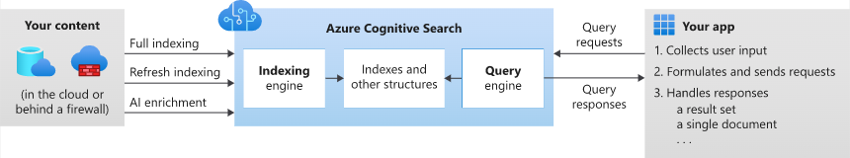
Azure AI Search
Formerly known as "Azure Cognitive Search"
cloud search service that gives developers infrastructure, APIs, and tools for building a rich search experience
Capabilities
A search engine for full text and vector search over a search index containing user-owned content
Rich indexing, with lexical analysis and optional AI enrichment for content extraction and transformation
Rich query syntax for vector queries, text search, fuzzy search, autocomplete, geo-search and more
Programmability through REST APIs and client libraries in Azure SDKs
Azure integration at the data layer, machine learning layer, and AI (Azure AI services)

Slide 6
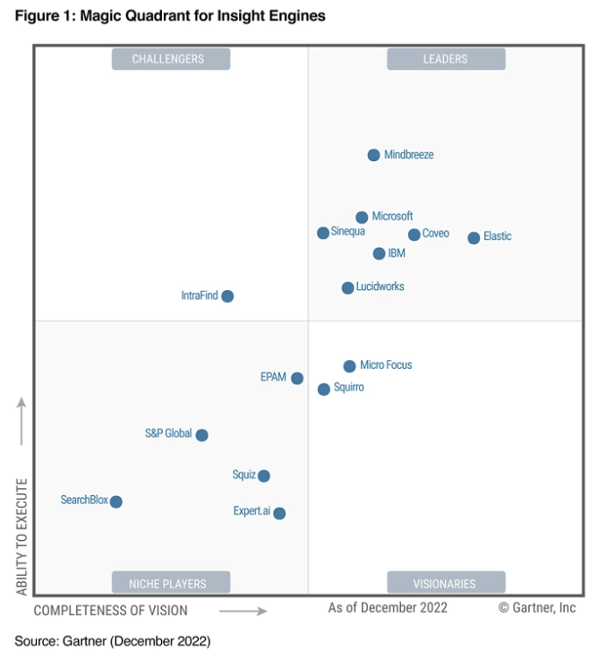

A leader in the industry…
“Microsoft is a Leader in this Magic Quadrant. Its Microsoft Search and Azure Cognitive Search products are broadly focused on EX and CX applications for digital workplace search and custom applications, respectively.”
Gartner Magic Quadrant, Insights Engine, 2022
©Garner, Inc

Slide 7
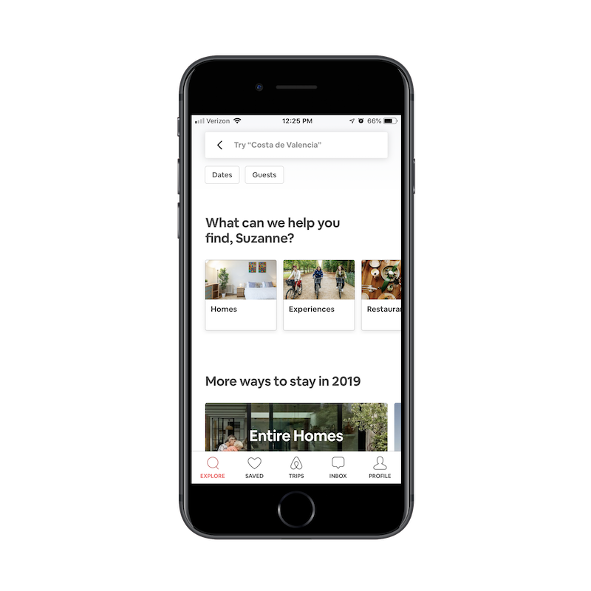

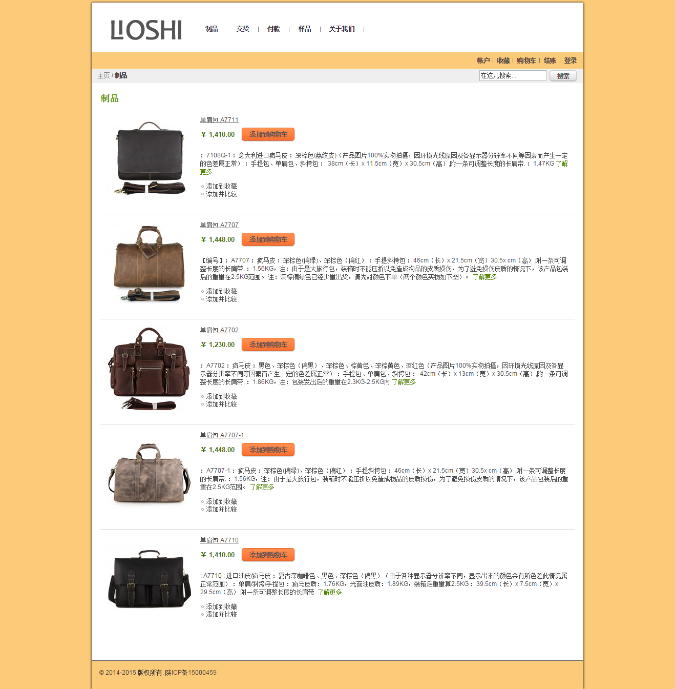

Common applications of Azure AI Search
Workplace Search
Help internal teams explore databases and files
SaaS Search
Build market-ready applications for customers
eCommerce
Help customers find and purchase products and services
Website Search
Help visitors find information quickly and easily
Improve efficiency and productivity
Enhance data accessibility
Improve decision-making
Improve user experience
Reduce development time
Provide personalized recommendations
Improve user experience
Enhance product discovery
Increase conversion rates
Increase findability
Better understand user behavior and needs

Slide 8
Key Terminology
Your searchable content available to the search engine
A table in general terms
Data Source
Sources for your Index
Indexer
Automate data import from supported data sources
Knowledge Store
A data sink from the enrichment pipeline
Skillsets
A set of AI Enrichments
Index

Slide 9

Indexing and Querying
Indexing
Querying
How to build a better mousetrap
Document Cracking
Retrieval
AI Enrichments (optional)
Ranking
Inverted Index
Query Results

Slide 10


Azure AI Search architecture
IEnricher
IEnricher
Cognitive Skill
Document Cracking
Skillset:
Extensible enrichment
pipeline
Indexing for Search
Customer Data
Annotated Documents
Search Index
Ingest Enrich Explore

Slide 11
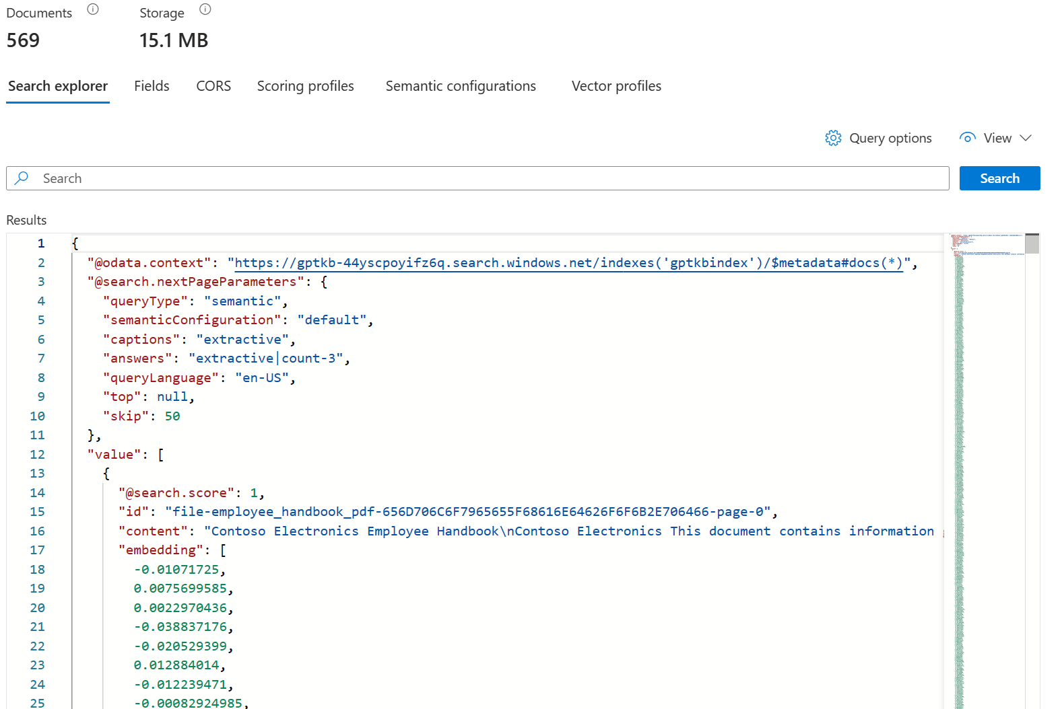
Index
Indexes contain search documents
a document is a single unit of searchable data in the index

Slide 12
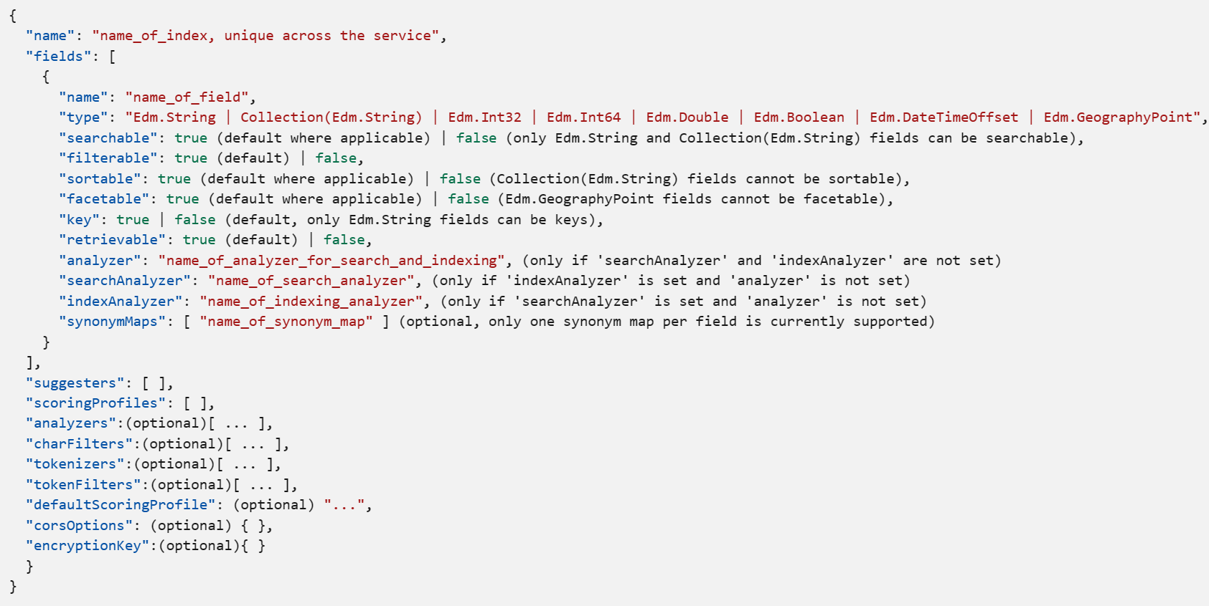
Index Schema
Index overview - Azure AI Search | Microsoft Learn

Slide 13
Index Field Attributes
Attribute | Description
"searchable" | Full-text searchable, subject to lexical analysis such as word-breaking during indexing. If you set a searchable field to a value like "sunny day", internally it's split into the individual tokens "sunny" and "day". For details, see How full text search works.
"filterable" | Referenced in $filter queries. Filterable fields of type Edm.String or Collection(Edm.String) don't undergo word-breaking, so comparisons are for exact matches only. For example, if you set such a field f to "sunny day", $filter=f eq 'sunny' finds no matches, but $filter=f eq 'sunny day' will.
"sortable" | By default the system sorts results by score, but you can configure sort based on fields in the documents. Fields of type Collection(Edm.String) can't be "sortable".
"facetable" | Typically used in a presentation of search results that includes a hit count by category (for example, hotels in a specific city). This option can't be used with fields of type Edm.GeographyPoint. Fields of type Edm.String that are filterable, "sortable", or "facetable" can be at most 32 kilobytes in length. For details, see Create Index (REST API).
"key" | Unique identifier for documents within the index. Exactly one field must be chosen as the key field and it must be of type Edm.String.
"retrievable" | Determines whether the field can be returned in a search result. This is useful when you want to use a field (such as profit margin) as a filter, sorting, or scoring mechanism, but don't want the field to be visible to the end user. This attribute must be true for key fields.
Index overview - Azure AI Search | Microsoft Learn

Slide 14
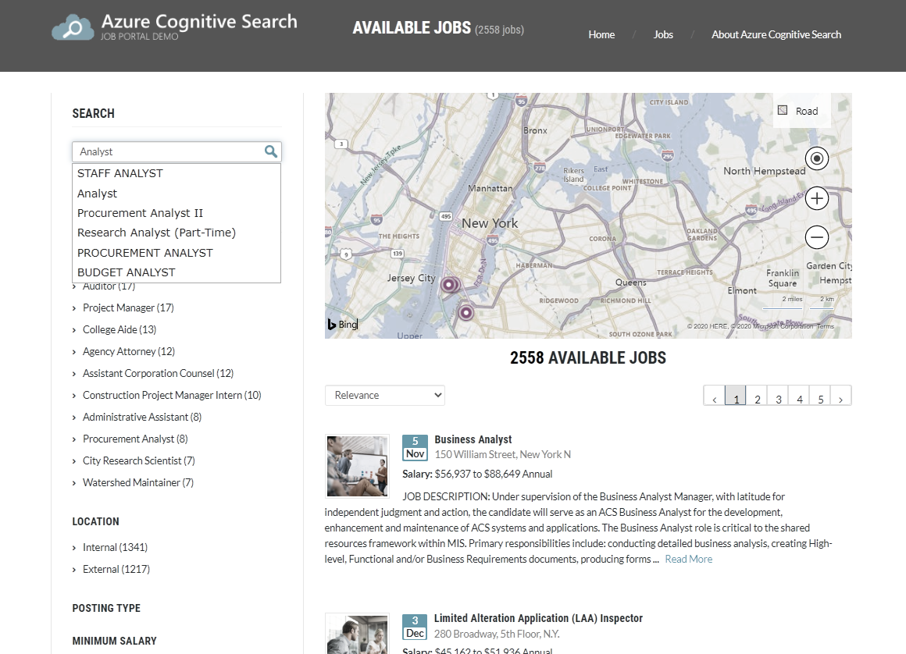
Spelling Mistakes
Geospatial Queries
Suggestions and Auto-complete
Paging
Filters and Facets
Ranking
Snippets and Highlights

Slide 15
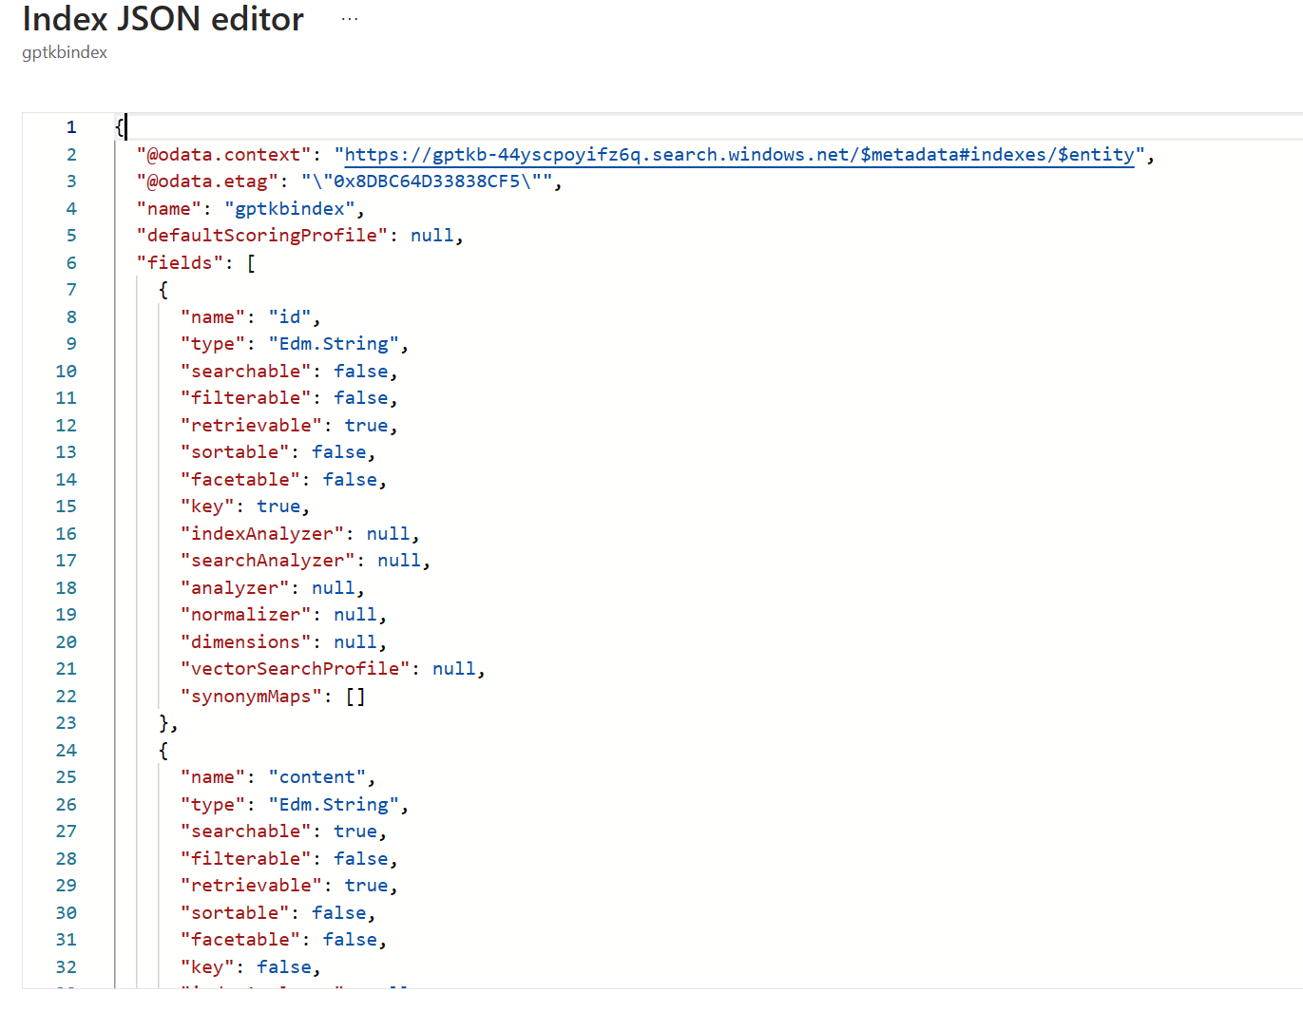
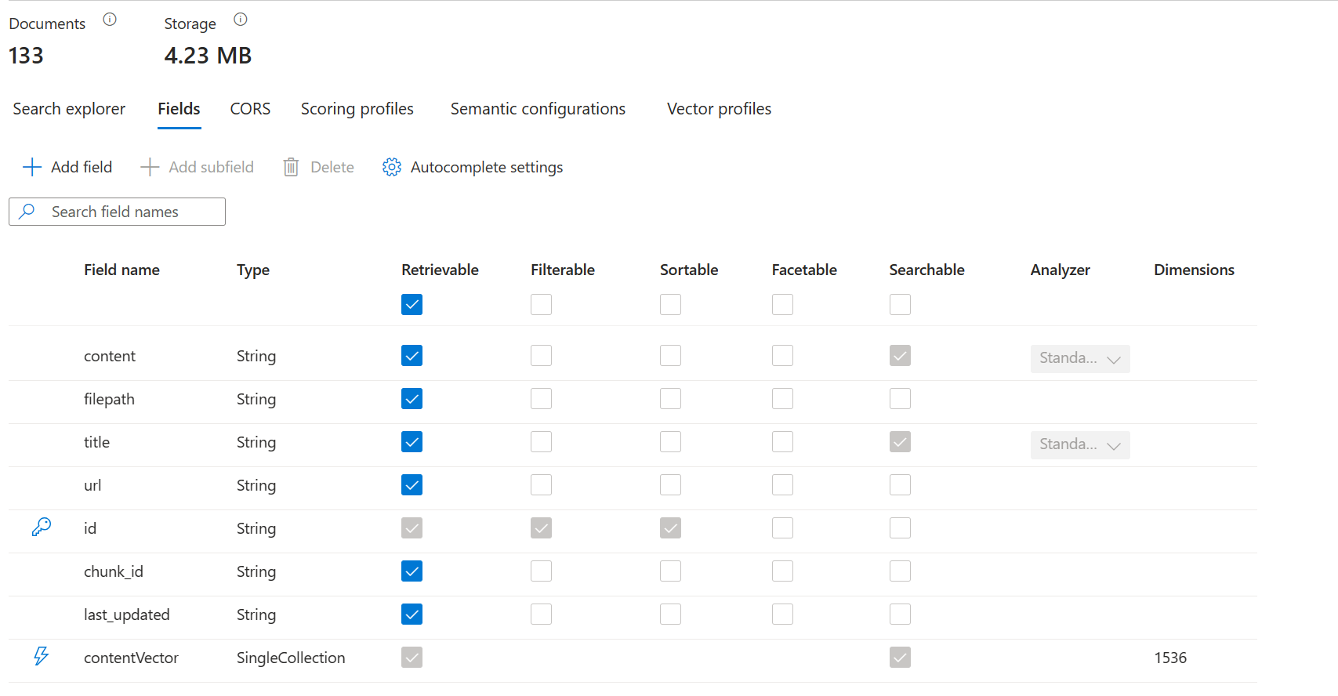

Slide 16
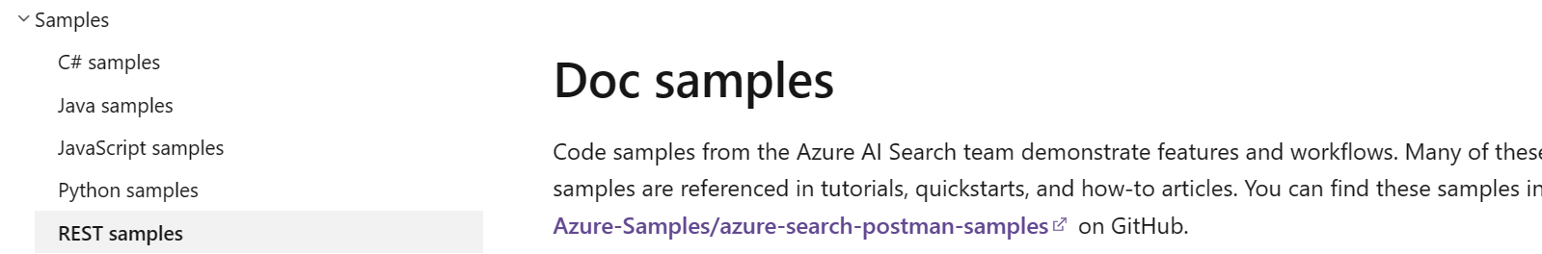
Data Import
“Pull”
“Push”
Automated data ingestion using our Indexer
Azure Blob storage
Azure Table storage
Azure Data Lake Storage Gen2
Azure Files (preview)
Azure Cosmos DB
Azure SQL Database, SQL Managed Instance, and SQL Server on Azure VMs
SharePoint in Microsoft 365 (preview)
Connection defined with Data source
Utilize custom skills to generate embeddings and process data during indexing
Streamlined Indexing
Manual Data Ingestion giving you full control over the indexing process
Quick and easy to get started
High Flexibility
REST samples - Azure AI Search | Microsoft Learn
https://github.com/Azure-Samples/azure-search-postman-samples

Slide 17
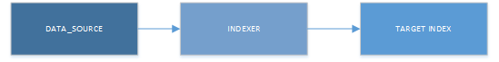
Indexer Scenarios
Scenario | Strategy
Single data source | This pattern is the simplest: one data source is the sole content provider for a search index. Most supported data sources provide some form of change detection so that subsequent indexer runs pick up the difference when content is added or updated in the source.
Multiple data sources | An indexer specification can have only one data source, but the search index itself can accept content from multiple sources, where each indexer run brings new content from a different data provider. Each source can contribute its share of full documents, or populate selected fields in each document. For a closer look at this scenario, see Tutorial: Index from multiple data sources.

Slide 18
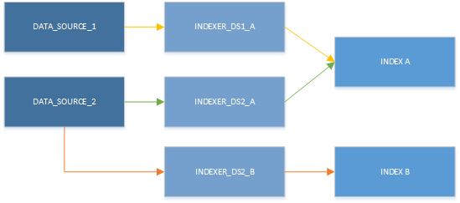
Indexer Scenarios
Scenario | Strategy
Multiple indexers | Multiple data sources are typically paired with multiple indexers if you need to vary run time parameters, the schedule, or field mappings. Cross-region scale out of Azure AI Search is another scenario. You might have copies of the same search index in different regions. To synchronize search index content, you could have multiple indexers pulling from the same data source, where each indexer targets a different search index in each region. Parallel indexing of very large data sets also requires a multi-indexer strategy, where each indexer targets a subset of the data.
Content transformation | Indexers drive AI enrichment. Content transforms are defined in a skillset that you attach to the indexer.

Slide 19
Azure AI Search architecture
IEnricher
IEnricher
Cognitive Skill
Document Cracking
Skillset:
Extensible enrichment
pipeline
Indexing for Search
Customer Data
Annotated Documents
Search Index
Ingest Enrich Explore

Slide 20




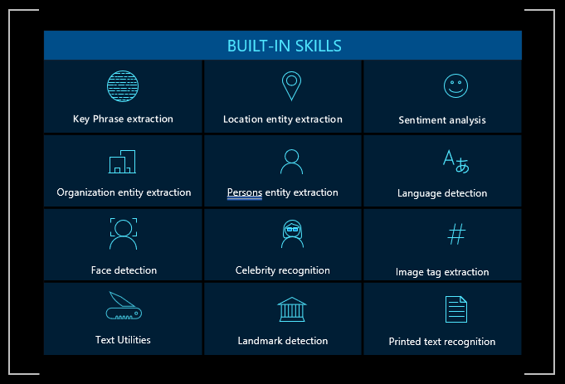




AI Enrichment
Customers can also integrate with other Azure AI services or build custom skills and models:
Built-in skills in Azure AI Search are based on pre-trained machine learning models in Azure AI services APIs and fall into two categories:
(Examples of common service combinations)
+
Azure OpenAI
Create vector embeddings
Natural Language Processing
Based on Azure AI Azure AI Text Analytics
Image Processing
Based on Azure AI Vision
+
Azure AI Document Intelligence
Extract key-value pairs from customer/patient intake forms or invoices
Azure AI Speech, Azure AI Bot Service
Use speech to text for analyzing customer calls and surface suggested answers with Azure AI Bot Service to automate field service
+
+
Azure AI Video Analyzer
Analyze and search video content (e.g., CCTV footage, focus group recording, in-store behavior, media clips, etc.)
+
Bing Web Search APIs
Search the web for latest details on detected entities in documents (people, places, cases, regulations, etc.)
+
Build Custom Skills
Extend AI enrichment by using Azure OpenAI LLM, building custom skills or training Azure Machine Learning models

Slide 21
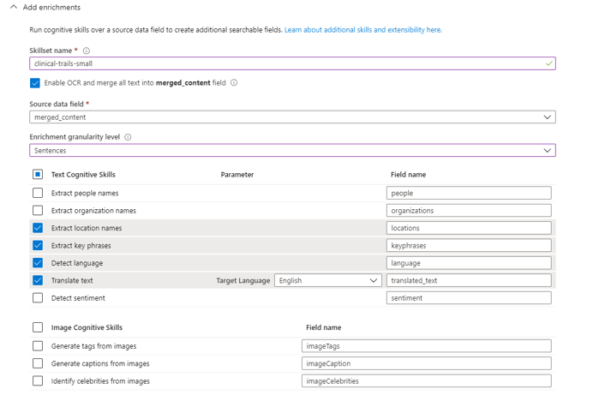

Adding built-in skills
Enable in the Portal
Add Programmatically

Slide 22
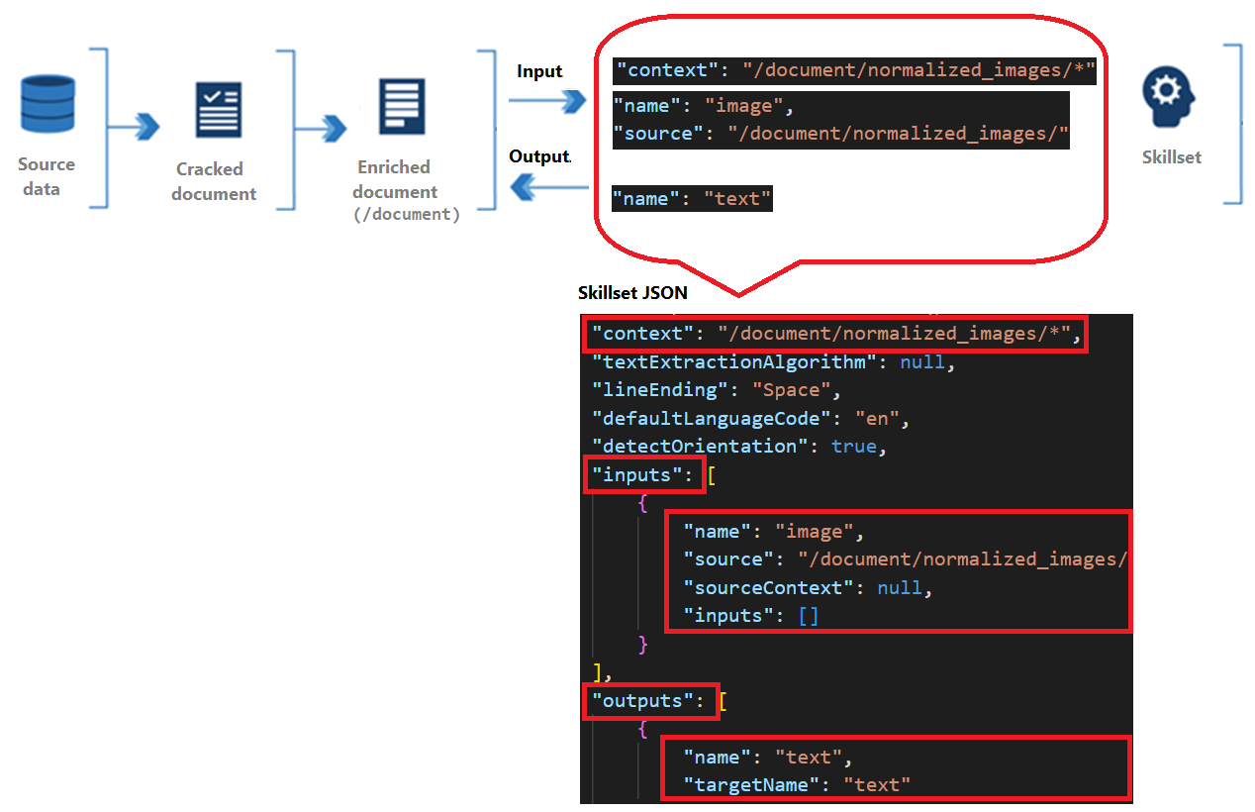
Skillset Definition

Slide 23
Skillset: Basic Example
Extract Key Phrases
keyPhrases
content
Extract Organizations
organizations
Classify Document
docClass

Slide 24
Skillset
You can create enrichment chains
content
Extract KeyPhrases
content
Detect Language
language
Organization Extraction
orgs
Get Internal Organization ID
content
normalized images
Get Tags
tags

Slide 25
Skillset
"skills": [
{
"@odata.type": "#Microsoft.Skills.Text.LanguageDetectionSkill",
"inputs": [
{ "name": "text", "source": "/document/content" }
], "outputs": [ { "name": "languageCode", "targetName": "myLanguageCode" },
{ "name": "languageName", "targetName": "myLanguageName" }
]
},

Slide 26
Skillset
…,
{
"@odata.type": "#Microsoft.Skills.Text.NamedEntityRecognitionSkill",
"categories": [ "Organization" ],
"defaultLanguageCode": "en",
"inputs": [
{ "name": "text", "source": "/document/content" }, { "name": "languageCode", "source": "/document/myLanguageCode" }
], "outputs": [
{ "name": "organizations", "targetName": "organizations" }
]
},

Slide 27
Skillset
You can create enrichment chains
content
Extract KeyPhrases
content
Detect Language
language
Organization Extraction
orgs
Get Internal Organization ID
content
normalized images
Get Tags
tags

Slide 28
Skillset
…,
{
"@odata.type": "#Microsoft.Skills.Text.NamedEntityRecognitionSkill",
"categories": [ "Organization" ],
"defaultLanguageCode": "en",
"inputs": [
{ "name": "text", "source": "/document/content" }, { "name": "languageCode", "source": "/document/myLanguagecode" }
], "outputs": [
{ "name": "organizations", "targetName": "organizations" }
]
},

Slide 29
Skillset
…,
{
"@odata.type": "#Microsoft.Skills.Custom.WebApiSkill", "uri": "https://myskill.azurewebsites.net/api/OrgId"
"context": "/document/organizations/*" ,
"httpHeaders": {"Api-Key": "mySecret" },
"inputs": [
{ "name": “organizationName", "source": "/document/organizations/*" },
], "outputs": [
{ "name": "organizationId", "targetName": "organizationId" }
]
},

Slide 30
Azure AI Search architecture
IEnricher
IEnricher
Cognitive Skill
Document Cracking
Skillset:
Extensible enrichment
pipeline
Indexing for Search
Customer Data
Annotated Documents
Search Index
Ingest Enrich Explore

Slide 31
Document Annotation

Slide 32
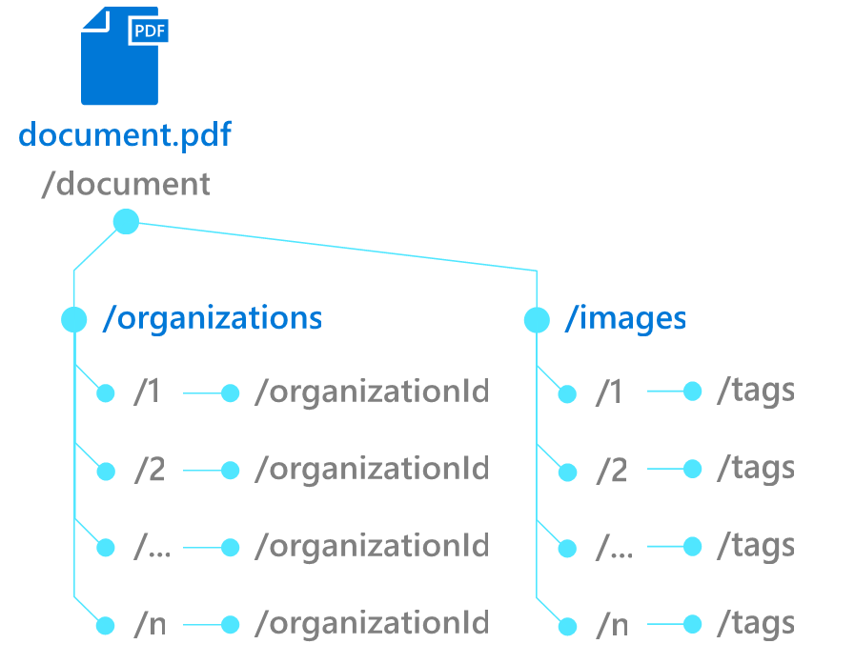

Field Mappings
New Indexer Property
{ …
"outputFieldMappings":
[
{ "sourceFieldName": "/document/organizations/*/organizationId",
"targetFieldName":
"orgIds"
} , …
]
}

Slide 33
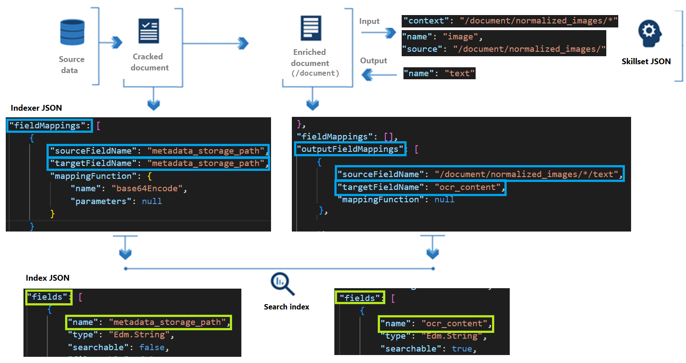
Indexer Definition

Slide 34

Knowledge Store
IEnricher
IEnricher
Cognitive Skill
Document Cracking
Skillset:
Extensible enrichment
pipeline
Source Data
Enriched Documents
Search Index
Projections
Knowledge Store

Slide 35
Knowledge Store Projection Types
Projection | Storage | Usage
Tables | Azure Table Storage | Used for data that's best represented as rows and columns, or whenever you need granular representations of your data (for example, as data frames). Table projections allow you to define a schematized shape, using a Shaper skill or use inline shaping to specify columns and rows. You can organize content into multiple tables based on familiar normalization principles. Tables that are in the same group are automatically related.
Objects | Azure Blob Storage | Used when you need the full JSON representation of your data and enrichments in one JSON document. As with table projections, only valid JSON objects can be projected as objects, and shaping can help you do that.
Files | Azure Blob Storage | Used when you need to save normalized, binary image files.

Slide 36



Cognitive Search A new capability of Azure Search
IEnricher
IEnricher
Cognitive Skill
Document Cracking
Skillset:
Extensible enrichment
pipeline
Source Data
Enriched Documents
Search Index
Analytics
Retrieval
Projections
Knowledge Store
Machine Learning
Human Validation

Slide 37
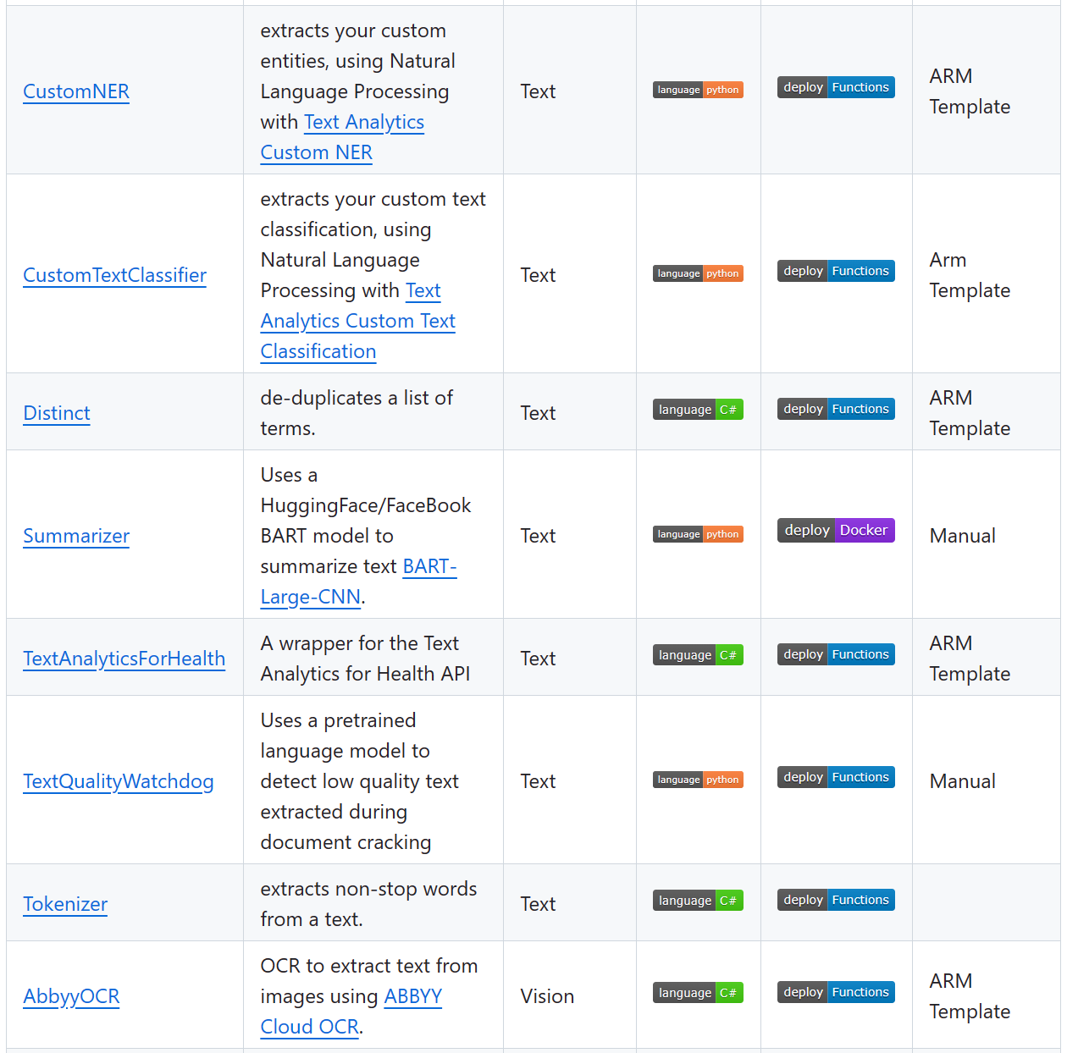
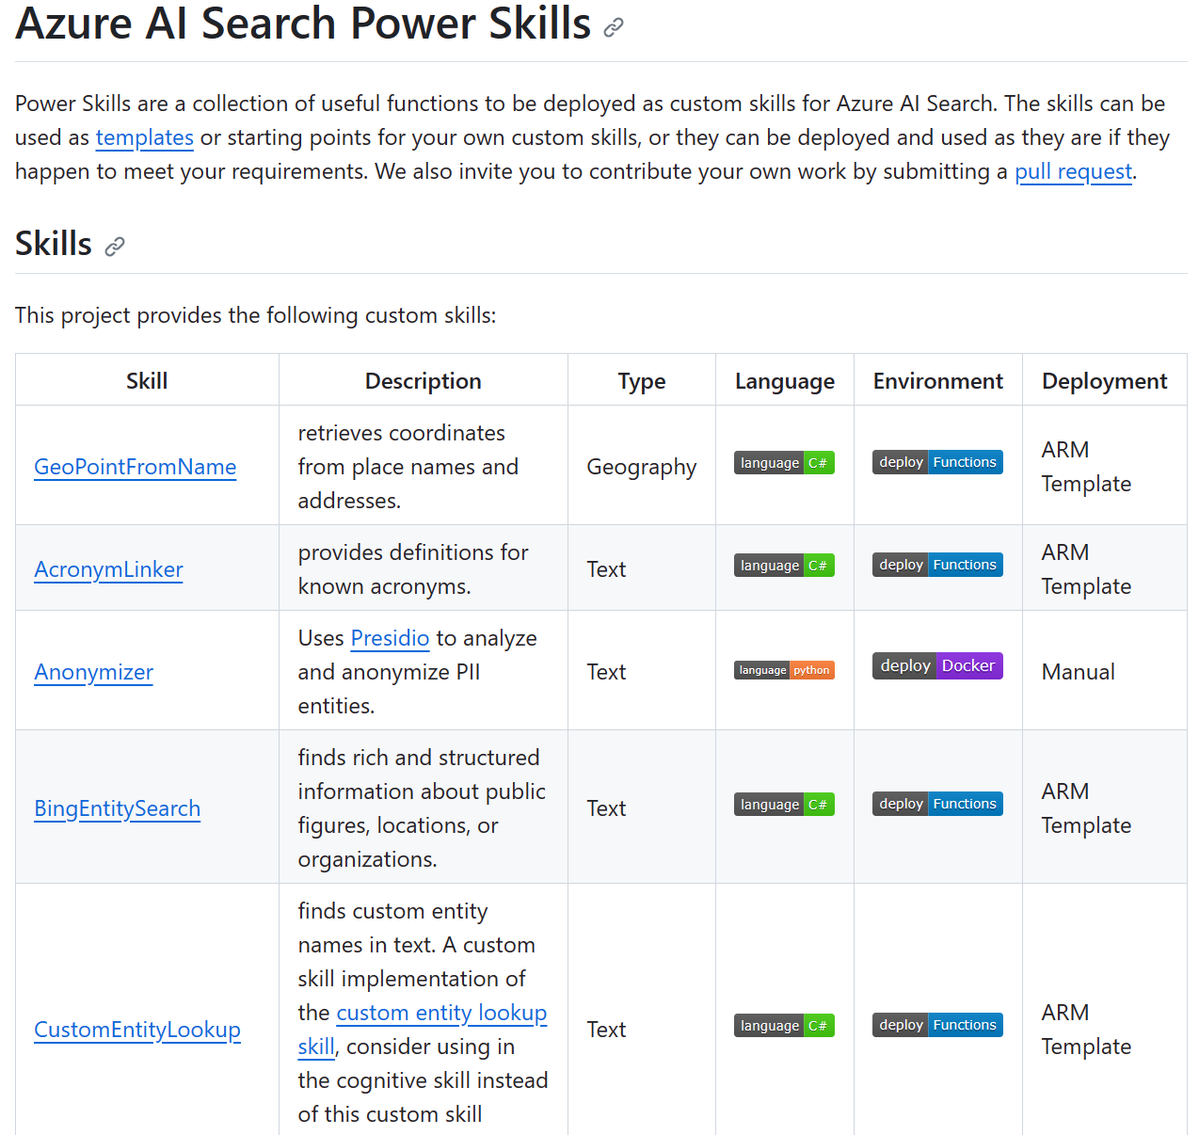
Power Skills Repo
https://aka.ms/powerskills

Slide 38
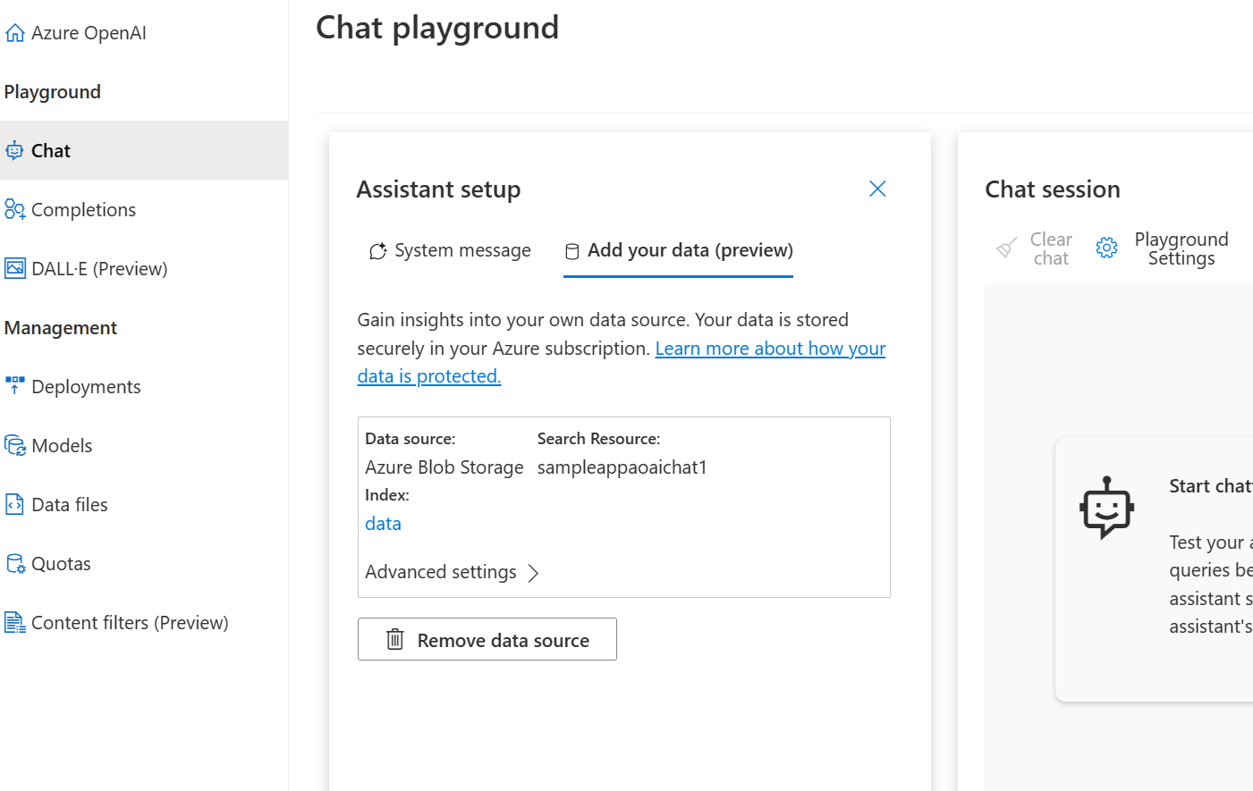
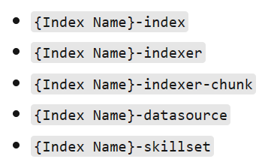
Azure AI / OpenAI Studio Add your data
Using Pull mode with knowledge store for index creation
Intermediate assets are created in the Azure AI Search resource:
Using your data with Azure OpenAI Service - Azure OpenAI | Microsoft Learn

Slide 39
Indexer 1 – to get documents from Blob Storage
{
"@odata.context": "https://sampleappaoaichat1.search.windows.net/$metadata#indexers/$entity",
"@odata.etag": "\"0x8DBE66618B186FB\"",
"name": "data-indexer",
"description": null,
"dataSourceName": "data-datasource",
"skillsetName": "data-skillset",
"targetIndexName": "data-index",
"disabled": false,
"schedule": {
"interval": "PT30M",
"startTime": "2023-11-16T05:07:15.345Z"
},
"parameters": {
"batchSize": null,
"maxFailedItems": null,
"maxFailedItemsPerBatch": null,
"base64EncodeKeys": null,
"configuration": {
"indexedFileNameExtensions": ".txt,.md,.html,.pdf,.docx,.pptx",
"dataToExtract": "contentAndMetadata"
}
},
"fieldMappings": [
{
"sourceFieldName": "metadata_storage_path",
"targetFieldName": "document_id",
"mappingFunction": {
"name": "base64Encode",
"parameters": null
}
},
{
"sourceFieldName": "metadata_storage_name",
"targetFieldName": "filename",
"mappingFunction": null
},
{
"sourceFieldName": "metadata_storage_path",
"targetFieldName": "url",
"mappingFunction": null
}
],
"outputFieldMappings": [],
"cache": null,
"encryptionKey": null
}

Slide 40
{
"name": "filename",
"source": "/document/filename"
},
{
"name": "fieldname",
"source": "='content'"
},
{
"name": "text",
"source": "/document/content"
}
],
"outputs": [
{
"name": "chunks",
"targetName": "chunks"
}
],
"httpHeaders": {
"original_request_id": “XXXXXX",
"original_internal_id": “xxxxxx",
"num_tokens": "1024",
"embedding_endpoint": "https://chat-with-your-data-solution-accelerator1.openai.azure.com/openai/deployments/text-embedding-ada-002/embeddings?api-version=2023-03-31-preview",
"embedding_key": “xxxxxxx",
"api-key": “xxxxxxxx"
}
}
],
Skillset for Indexer 1 call custom skill
{
"@odata.context": "https://sampleappaoaichat1.search.windows.net/$metadata#skillsets/$entity",
"@odata.etag": "\"0x8DBE661E629C603\"",
"name": "data-skillset",
"description": null,
"skills": [
{
"@odata.type": "#Microsoft.Skills.Custom.WebApiSkill",
"name": "data-skillset",
"description": null,
"context": "/document/content",
"uri": "https://chat-with-your-data-solution-accelerator1.openai.azure.com/openai/chunks?api-version=2023-03-31-preview",
"httpMethod": "POST",
"timeout": "PT3M",
"batchSize": 1,
"degreeOfParallelism": 1,
"inputs": [
{
"name": "document_id",
"source": "/document/document_id"
},

Slide 41
Skillset for Indexer 1 – sink output to knowledge store
{
"name": "title",
"source": "/document/content/chunks/*/title",
"sourceContext": null,
"inputs": []
},
{
"name": "url",
"source": "/document/url",
"sourceContext": null,
"inputs": []
},
{
"name": "chunk_id",
"source": "/document/content/chunks/*/chunk_id",
"sourceContext": null,
"inputs": []
},
{
"name": "last_updated",
"source": "/document/content/chunks/*/last_updated",
"sourceContext": null,
"inputs": []
},
{
"name": "contentVector",
"source": "/document/content/chunks/*/contentVector",
"sourceContext": null,
"inputs": []
}
]
}
],
"files": []
}
],
"parameters": {
"synthesizeGeneratedKeyName": true
}
},
"indexProjections": null,
"encryptionKey": null
}
"cognitiveServices": null,
"knowledgeStore": {
"storageConnectionString": “xxxxxxxxxxx",
"identity": null,
"projections": [
{
"tables": [],
"objects": [
{
"storageContainer": "data-chunks",
"referenceKeyName": null,
"generatedKeyName": "id",
"source": null,
"sourceContext": "/document/content/chunks/*",
"inputs": [
{
"name": "content",
"source": "/document/content/chunks/*/content",
"sourceContext": null,
"inputs": []
},
{
"name": "filepath",
"source": "/document/filename",
"sourceContext": null,
"inputs": []
},

Slide 42
Indexer 2 – load data from Knowledge Store
{
"@odata.context": "https://sampleappaoaichat1.search.windows.net/$metadata#indexers/$entity",
"@odata.etag": "\"0x8DBE66617AE6DCE\"",
"name": "data-indexer-chunk",
"description": null,
"dataSourceName": "data-datasource-chunk",
"skillsetName": null,
"targetIndexName": "data",
"disabled": false,
"schedule": {
"interval": "PT30M",
"startTime": "2023-11-16T05:07:15.65Z"
},
"parameters": {
"batchSize": null,
"maxFailedItems": null,
"maxFailedItemsPerBatch": null,
"base64EncodeKeys": null,
"configuration": {
"parsingMode": "json",
"indexedFileNameExtensions": ".json"
}
},
"fieldMappings": [],
"outputFieldMappings": [],
"cache": null,
"encryptionKey": null
}

Slide 43
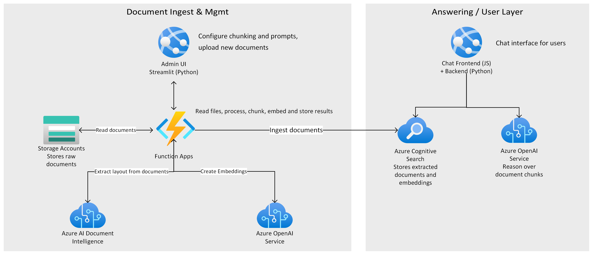
“Chat with your data” solution accelerator
Document upload auto triggers Azure Function to chunk the documents and add embeddings
Using Push mode to create index
Introducing the “Chat with your data” solution accelerator – now available on GitHub - Microsoft Community Hub

Slide 44
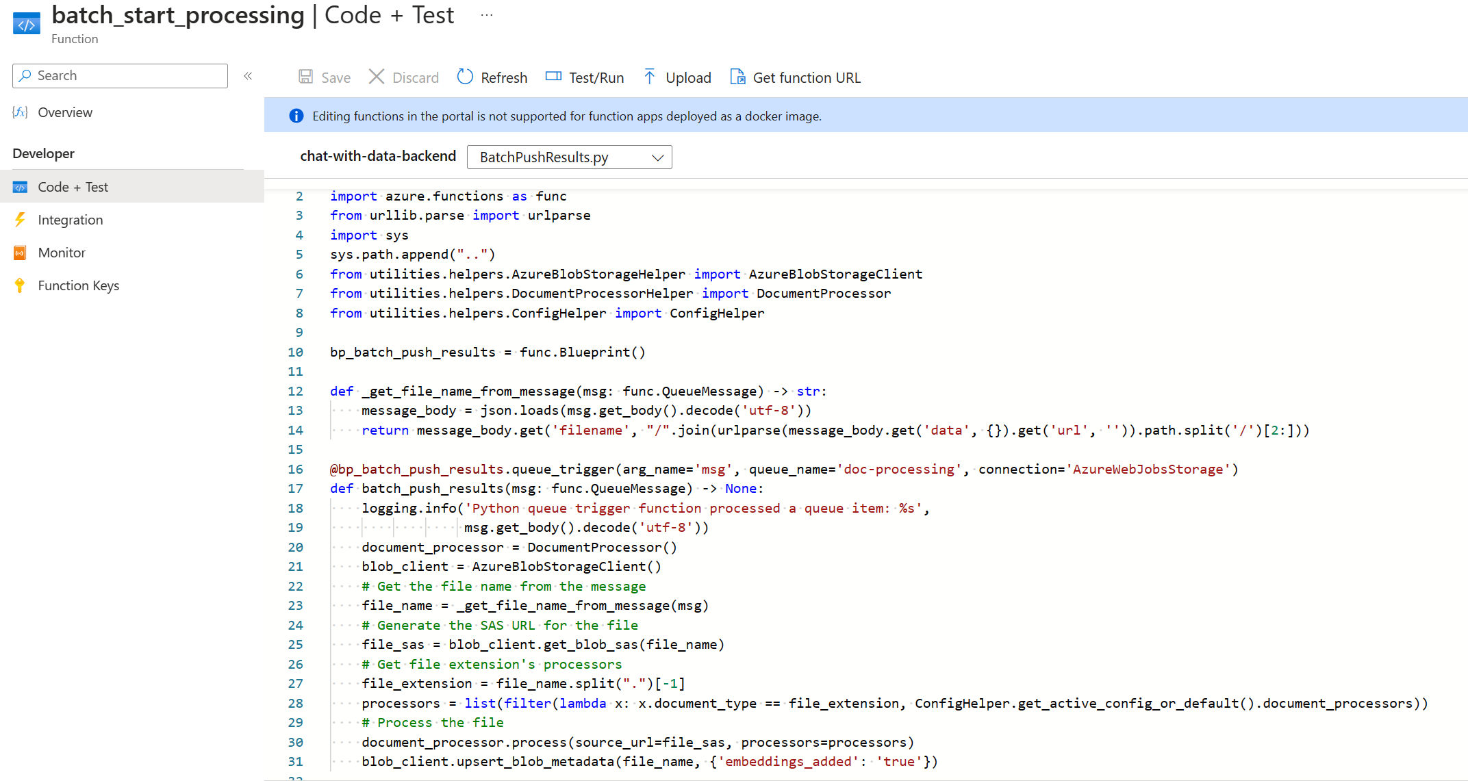

Slide 45
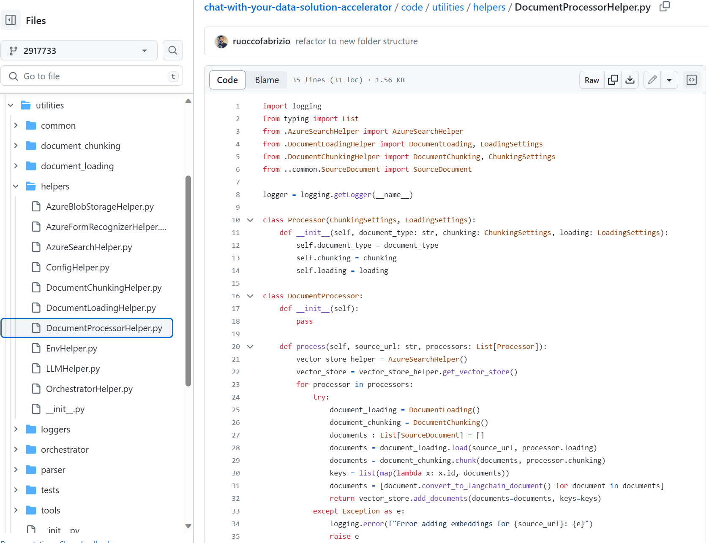

Slide 46
Azure AI Search architecture
IEnricher
IEnricher
Cognitive Skill
Document Cracking
Skillset:
Extensible enrichment
pipeline
Indexing for Search
Customer Data
Annotated Documents
Search Index
Ingest Enrich Explore

Slide 47

Querying Modes
Retrieval
Ranking
Often called L1, the goal is to quickly find all the documents from the index that satisfy the search criteria. These are scored to pick the top few (typically in the order of 50) to return to the user or to feed to the next layer. Azure Cognitive Search supports (3) different L1 modes:
Also called L2, takes a subset of the top L1 results and computes higher quality relevance scores to reorder the result set.
Keyword
Vector
Hybrid
Semantic Ranking
Exact keyword based
Relevance via Boolean Search
Ranking via BM25 probabilistic model
Vector representation of your data
Uses power of vector and semantic
AI Search currently uses Reciprocal Rank Fusion (RRF) to produce a single result set
Formerly known as "semantic search"
Utilizes multi-lingual, deep learning models adapted from Microsoft Bing
Relevancy is based on the semantics of the user’s query and detects domain-specific patterns
General Availability
General Availability

Slide 48
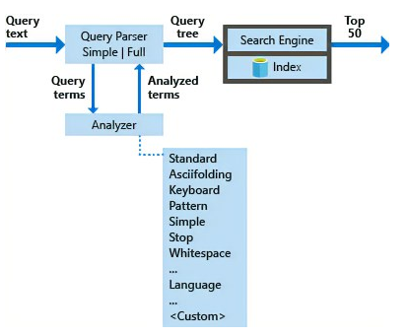
Retrieval Basics Traditional information retrieval
Query: Formal statement representing your information need (e.g., search string)
Object: Entity within your content collection (e.g., document, image, audio)
Relevance: Quantitative measure of how well an object satisfies the intent of the query
Ranking: Ordered list of relevant results based on their desirability or relevance score

Slide 49
Keyword Search Search via Inverted Indexes
Document 1:
“apple orange banana”
Term | Freq | Documents
apple | 3 | 1, 2, 3
orange | 2 | 1, 2
banana | 2 | 1, 3
grape | 2 | 2, 3
Document 2:
“orange apple grape”
Document 3:
“banana grape apple”
Dictionary
Postings Lists

Slide 50
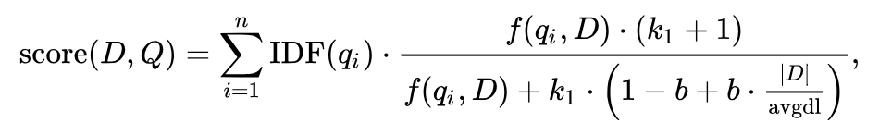
Keyword Search Ranking & Relevance in Traditional Search
Relevance via Boolean Search: Retrieve documents containing specific terms (e.g., "apples" AND "oranges")
Ranking via BM25: A ranking algorithm influenced by 3 key factors:
Term Frequency (TF): More occurrences of the search term indicate higher relevance
Inverse Document Frequency (IDF): The rarer a term across documents, the more important it is
Field Length: Terms found in shorter fields (fewer words) are more likely to be relevant than terms in longer fields (more words)
BM25 formula

Slide 51
Combining Discrete and Semantic Representations for Optimal Recall Leveraging the Strengths of Lexical and Semantic Approaches in Retrieval
Discrete (Lexical) Representations
Dense (Vector) Representations
Advantages:
Exact matching
Precise control and easy explainability
Limitations:
Struggle to capture nuances in language
Limited understanding of conceptual similarity
Advantages:
Capture conceptual similarity
Better understanding of language nuances
Limitations:
Not built to match exact terms
Reduced explainability compared to discrete
Bottom Line: Achieve optimal recall by leveraging the strengths of both discrete and semantic representations for a comprehensive understanding of language

Slide 52
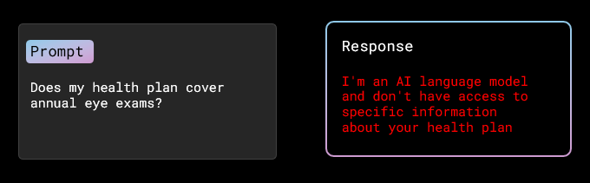
What is RAG?
Problem: Generative AI doesn’t have context for your data - and it doesn't know your data

Slide 53
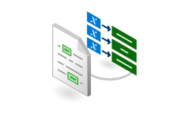
Anatomy of RAG Components
2
5
Search query / questions (incl. filters, facets, scoring profiles, etc.)
?
Section 1
Expert Systems
Section 2
User
Application
Azure Cognitive
Search
1
Document Chunking
Function
Section 3
Search Index
Section 4
Azure Form Recognizer
Layout Model
3
Azure OpenAI
Service
Response:
Summarization,
Q&A, references, etc.
N-Relevant Sections
Prompt
4
Document Library
1. Data Ingestion
2. Chunking
3. Indexing
4. Prompting
5. User Interface
Different data formats and system of records
What is the best chunking strategy suits?
Shall I use Vectors, Semantic or traditional approach?
Tools, techniques and strategies of prompting
How to surface data?

Slide 54
Enhancing RAG with Advanced Retrieval Features Investing in cutting-edge retrieval technology for improved results
RAG
Azure AI Search is committed to providing the BEST retrieval solution through:
Vector Search capabilities
Hybrid Search
Advanced filtering
Document security
L2 reranking/optimization
Built-in chunking
Auto-Vectorization
And much more!
The quality of the retriever is critical!

Slide 55



Vector Search at a High Level
Scenario
The Challenge
The Solution
A diverse collection of books, each containing unique insights and knowledge
Finding a book on a specific topic or theme can be time-consuming and overwhelming, especially when the content is scattered.
A skilled librarian can quickly connect you to books with similar topics or themes

Slide 56


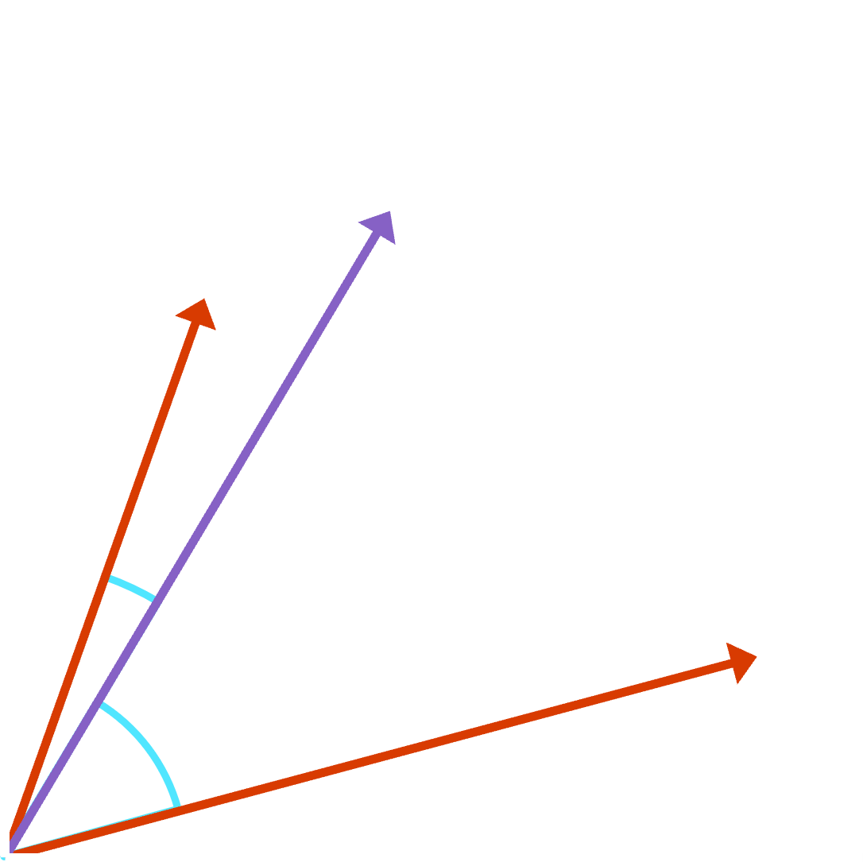
Vector Search: Deeper Dive
Scenario
The Challenge
The Solution
Organizations need efficient methods to retrieve semantically similar items from large-scale data sources.
Sifting through large-scale databases to find related items can be resource-intensive and time-consuming.
By calculating similarity metrics like cosine similarity, vector search organizes data and retrieves semantically similar items within the high-dimensional space.

Slide 57
Embeddings: Convert Data into Vector Representation Simplifying complex data structures for efficient analysis and processing in various applications.
Definition
Purpose
Benefits
Abstract, dense, compact, learned numerical representations of data
Map complex structures into simpler, fixed-size vectors
Applicable to diverse data types (text, images, audio, etc.)
Facilitate analysis and processing of diverse data types
Enable similarity measurement, clustering, and classification
Power applications like Vector search and recommendation systems
Efficient search and organization of vast datasets
Improved accuracy and relevance of search results
Scalable and adaptable to various industries and use cases

Slide 58

Why do I need embeddings? Vectors are a universal representation of data
3.4MB
0.1912
0.4123
. . .
0.9128
4.1MB
1.1GB

Slide 59





Find relevant objects with embeddings Convert data vectors (embeddings) and find the most similar objects according to metric
Data Sources
Vector Representation
Vector index
Vector Representation
App/UX
Images
-2, -1 , 0, 1
Audio
Azure Cognitive
Search
Transform using embedding model
2, 3, 4, 5
2, 3, 4, 5
Transform using embedding model
6, 7, 8, 9
Video
Text
Results
...and more!

Slide 60
Choosing an Embedding Model Key Factors for Selecting the Optimal Model for Your Use Case
Model Characteristics
Implementation Considerations
Task Specificity
Performance
Context Awareness
Model Size and Inference Speed
Language Support
Customizability (ability to fine-tune)
Training Time and Complexity
Pre-Trained Models
Integration
Community Support and Updates
Cost
We recommend Azure OpenAI service “text-embedding-ada-002” for text embeddings
We recommend Azure AI Vision Image Retrieval API for image embeddings

Slide 61
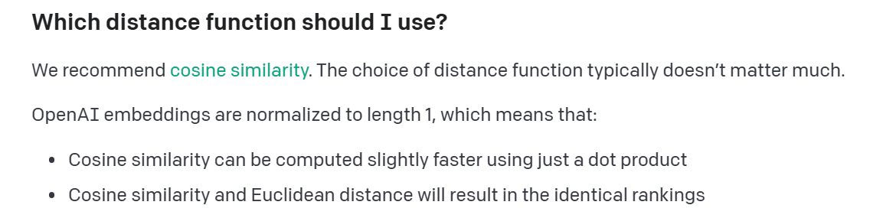
Similarity Metrics
Cosine similarity
Dot Product
Euclidean distance
Angular
Jaccard
Many more!
https://platform.openai.com/docs/guides/embeddings/which-distance-function-should-i-use

Slide 62



The Dream Scenario for Vector Search Effortless Data Management and Relevant Search Results
Dump a Bunch of Data
Run a Query
Get the Most Relevant Data Back
Common Challenges
Scalability
Preprocessing
Splitting/Chunking
Embedding management
Query understanding
Query flexibility
Ranking accuracy
Result Diversity
Search algorithm

Slide 63

Introducing vector search in Azure AI Search Revolutionize indexing and retrieval augmented generation for LLM Apps
General Available
Images
Audio
Video
Graphs
Text
Leverage data from any data store
Improve relevancy
Query across multiple types of data
Quickly search through large data sets
Deploy with enterprise-grade security
Easily scale with changing workloads
Build retrieval plugins for OpenAI's ChatGPT using Azure OpenAI service

Slide 64


Retrieval modes
Retrieval Modes Vector search is good, but Hybrid search is even better!
 | Full-text search (BM25) | Pure Vector search (ANN) | Hybrid search (BM25 + ANN)
Exact keyword match
Proximity search
Term weighting
Semantic similarity search
Multi-modal search
Multi-lingual search

Slide 65
Reciprocal Rank Fusion in Azure AI Search Hybrid Queries with BM25 and ANN Search Integration
Reciprocal Rank Fusion (RRF): A technique for combining the results of multiple search strategies, resulting in improved search relevance and ranking
Azure Cognitive Search incorporates RRF by merging the ranked results of BM25 and ANN search, allowing the best features of both methods to contribute to the final search relevance
https://plg.uwaterloo.ca/~gvcormac/cormacksigir09-rrf.pdf

Slide 66
Cost and Pricing Harness the Power of Vector Search at No Additional Cost
No additional cost for using Vector search!
Note: Cognitive Search does not generate embeddings out of the box, therefore, you are responsible for the cost of generating your embeddings. You only pay for the storage of the vectors.

Slide 67
Scale: OpenAI Text-Embedding-Ada-002 Example Choose the Right Tier to Meet Your Vector Index Size Needs
Tier | Vector index size GB/partition | Max index size for a service (GB)
Basic | 1 | 1
S1 | 3 | 36
S2 | 12 | 144
S3 | 36 | 432
L1 | 12 | 144
L2 | 36 | 432
For more information on how to calculate Vector index size, please visit Vector index size limit - Azure Cognitive Search | Microsoft Learn

Slide 68

How do I get started with vector search?
Generate document embeddings
Create your vector configuration
Generate query embedding
Ingest data sources
Add to your index
Search using vectors
Gather your data sources
Generate embeddings for your data using you own model
Insert your vectors into your search index as a collection of floats via the Push API or the Indexer via a Custom Embedding Skill
Configure your algorithm, similarity function, and parameters
Generate an embedding for your query using the same model as your docs
Search your index using a vector representation of your data

Slide 69
Introducing semantic ranker Outperform vector search with hybrid search + Semantic re-ranking
General Available
Search Configuration | Customer datasets [NDCG@3] | Beir [NDCG@10] | Multilingual Academic (MIRACL) [NDCG@10]
Keyword | 40.6 | 40.6 | 49.6
Vector (Ada-002) | 43.8 | 45.0 | 58.3
Hybrid (Keyword + Vector) | 48.4 | 48.4 | 58.8
Hybrid + Semantic ranker | 60.1 | 50.0 | 72.0
Formerly known as "semantic search"
SOTA re-ranking encoder model
Highest performing retrieval mode
New pay-go pricing: Free 1k requests/month, $1 per additional 1k
Multilingual capabilities
Includes extractive answers, captions and ranking (like Bing)
Our experiments have shown that Hybrid Search + Semantic L2 Reranking is 22.4% better than BM25 and 22.3% better than ANN search alone using OpenAI’s “text-embeddings-ada-002”. (evaluated using NDCG@3)

Slide 70
Vector Configuration w/Azure OpenAI service Vectorizer
"vectorSearch": {
"algorithms": [
{
"name": "myHnsw",
"kind": "hnsw“
},
{
"name": "myExhaustiveKNN",
"kind": “exhaustiveKnn“
},
],
"vectorizers": [
{
"name": “myAzureOpenAIVectorizer",
"kind": "azureOpenAI",
"azureOpenAIParameters":
{
"resourceUri" : "https://my-openai.openai.azure.com",
"apiKey" : “xxx",
"deploymentId" : "text-embedding-ada-002"
}
},
],
"profiles": [
{
"name": "myHnswProfile",
"algorithm": "myHnsw",
"vectorizer":"myAzureOpenAIVectorizer"
}
]
},
I want to create a vector search configuration so that I can set the appropriate parameters for my search experience.

Slide 71
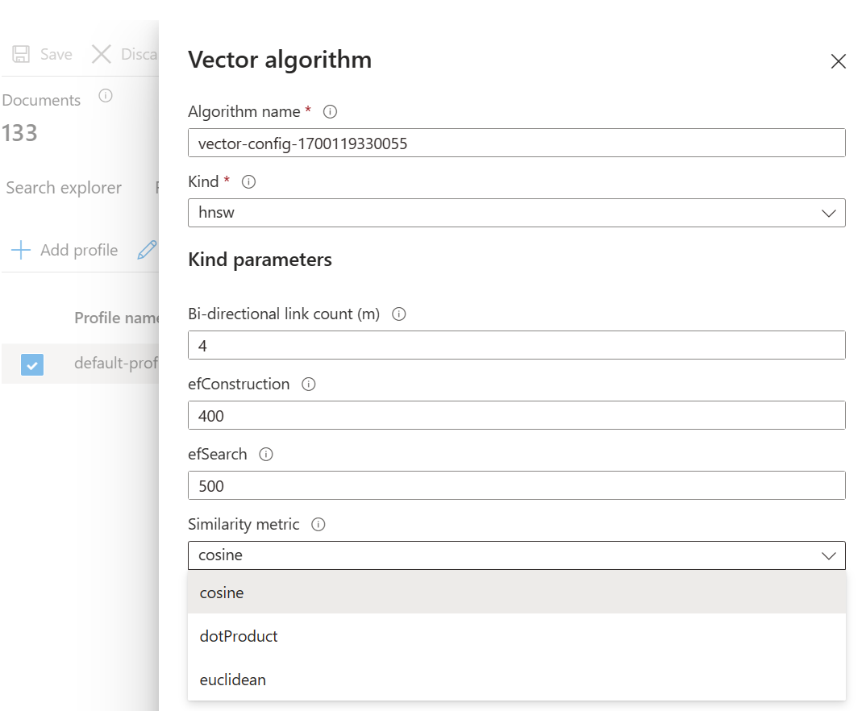
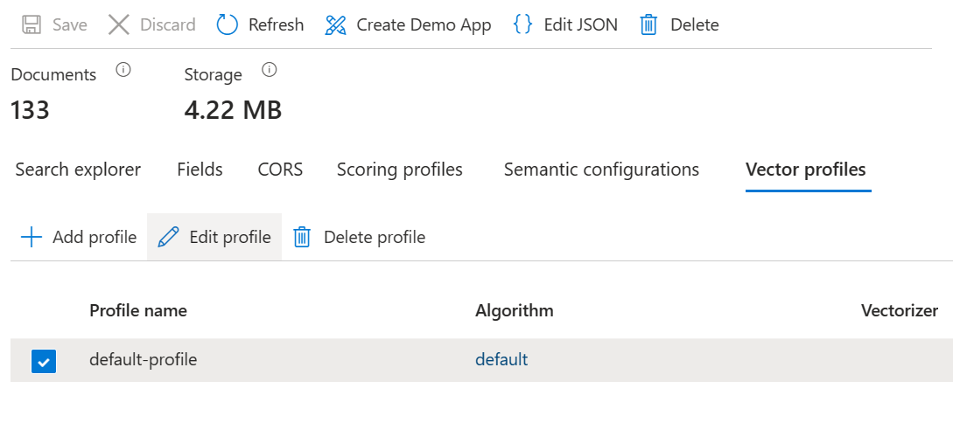
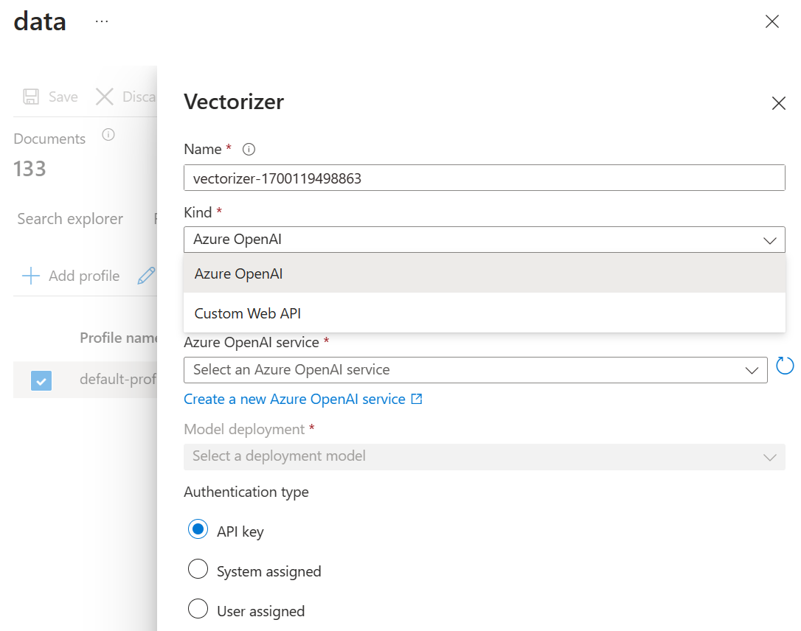
Vector Configuration

Slide 72
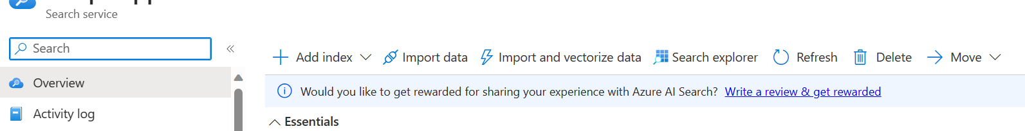
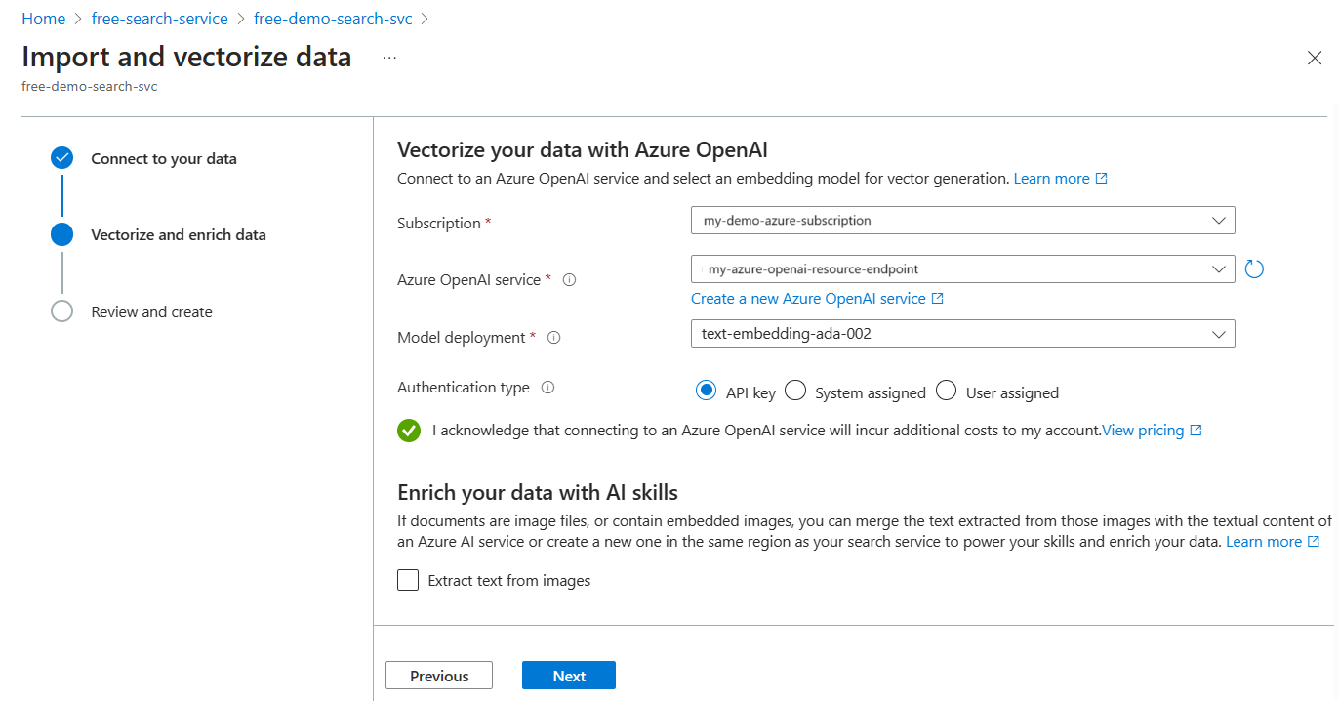
Integrated vectorization

Slide 73
Configure Vector fields in your Index Definition
{
"name": “contentVector",
"type": "Collection(Edm.Single)",
"dimensions": 1536,
“vectorSearchProfile": "my-vector-profile",
"searchable": true,
"retrievable": true | false,
"filterable": false,
"sortable": false,
"facetable": false
}
I want to create vector field types that will be supported in my nearest neighbor search.

Slide 74
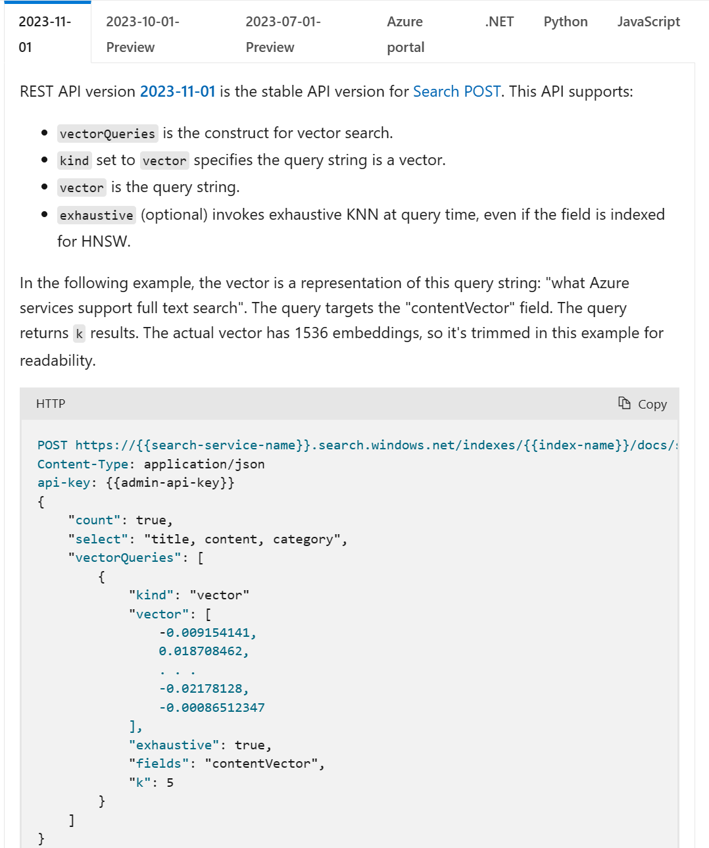
Vector Query
Vector query how-to - Azure AI Search | Microsoft Learn

Slide 75
Pure vector search (Exhaustive)
{
"vectorQueries": [
{
"kind": "text",
"text": “healthy foods",
"fields": "vector"
}
],
"exhaustive": "true",
}
I want to exhaustively search all the vectors in my index to find the ground-truth values.
Alternatively, you can use this with smaller index sizes.

Slide 76
Vectors search with Filters
{
"vectorQueries": [
{
"kind": "text",
"text": “healthy foods",
"fields": "vector"
}
],
"vectorFilterMode": "preFilter",
"filter": “category eq ‘fruits’"
}
I want to use vectors with pre-filtering, so that I can limit the number of matched documents. I also want to use query vectorization.

Slide 77
Pure Vector search w/Vectorizer or Raw Vector
{
"vectorQueries": [
{
"kind": "text",
"text": “healthy foods",
"fields": "vector"
}
],
}
I want to only use query vectorizer and to do a vector search and rank my search results by cosine similarity score, so that I get the full user intent of my search results.
{
"vectorQueries": [
{
"kind": "vector",
"vector": [1, 2, 3],
"fields": "vector"
}
],
}

Slide 78
Cross-Field Vector Query
{
"vectorQueries": [
{
"kind": "vector",
"vector": [1, 2, 3],
"fields": “titlevector, contentVector"
}
],
}
I want to use vectors and search over multiple fields so that I can leverage multiple vector fields into my similarity function.

Slide 79
Hybrid Search
{
"vectorQueries": [
{
"kind": "text",
"text": "healthy foods",
"fields": "vector"
}
],
"search": " healthy foods"
}
I want to use hybrid search (text + vectors) so that I can leverage both vectors and keywords for my search relevance.

Slide 80
Multi-Vector Query
City eq 'New York
{
"vectorQueries": [
{
"kind": "text",
"text": "yummy vanilla ice cream",
"fields": "textVector"
},
{
"kind": "text",
"text": "vanilla.png",
"fields": "imageVector"
}
],
}
I want to use multi-vector queries to pass in two different query embeddings for my multi-modal search use case using CLIP.

Slide 81
Hybrid Search with Semantic reranking
City eq 'New York
{
"vectorQueries": [
{
"kind": "text",
"text": "healthy foods",
"fields": "vector"
}
],
"search": “healthy foods”
"semanticConfiguration": “config"
"queryType": "semantic"
"answers": "extractive"
"captions": "extractive"
}
I want to use hybrid search (text + vectors) so that I can take advantage of vectors, keywords, and Semantic search capabilities such as captions and answers.

Slide 82
Generate document embeddings
docsEmbeddings.py
# generate document embeddings
def generate_embeddings(text):
response = openai.Embedding.create(
input=text, engine="text-embedding-ada-002")
embeddings = response['data'][0]['embedding']
return embeddings

Slide 83
Generate query embedding
queryEmbedding.py
# generate query embedding
response = openai.Embedding.create(
input=“healthy foods",
engine="text-embedding-ada-002"
)
embeddings = response['data'][0]['embedding']

Slide 84
Introducing Integrated Vectorization End-to-end data ingestion, chunking, vectorization, and advanced retrieval
Preview
Chunking
Built-in Chunking Skill (updates to split skill) and updates to index to manage chunks vs. full documents.
Configure Chunking parameters (e.g. pages, overlap window, etc)
Automated via Indexer orchestration
Vectorization
Bring-Your-Own Azure OpenAI Endpoint
Support for other embedding model REST endpoints through custom skill
Query Vectorization capability
Preview

Slide 85
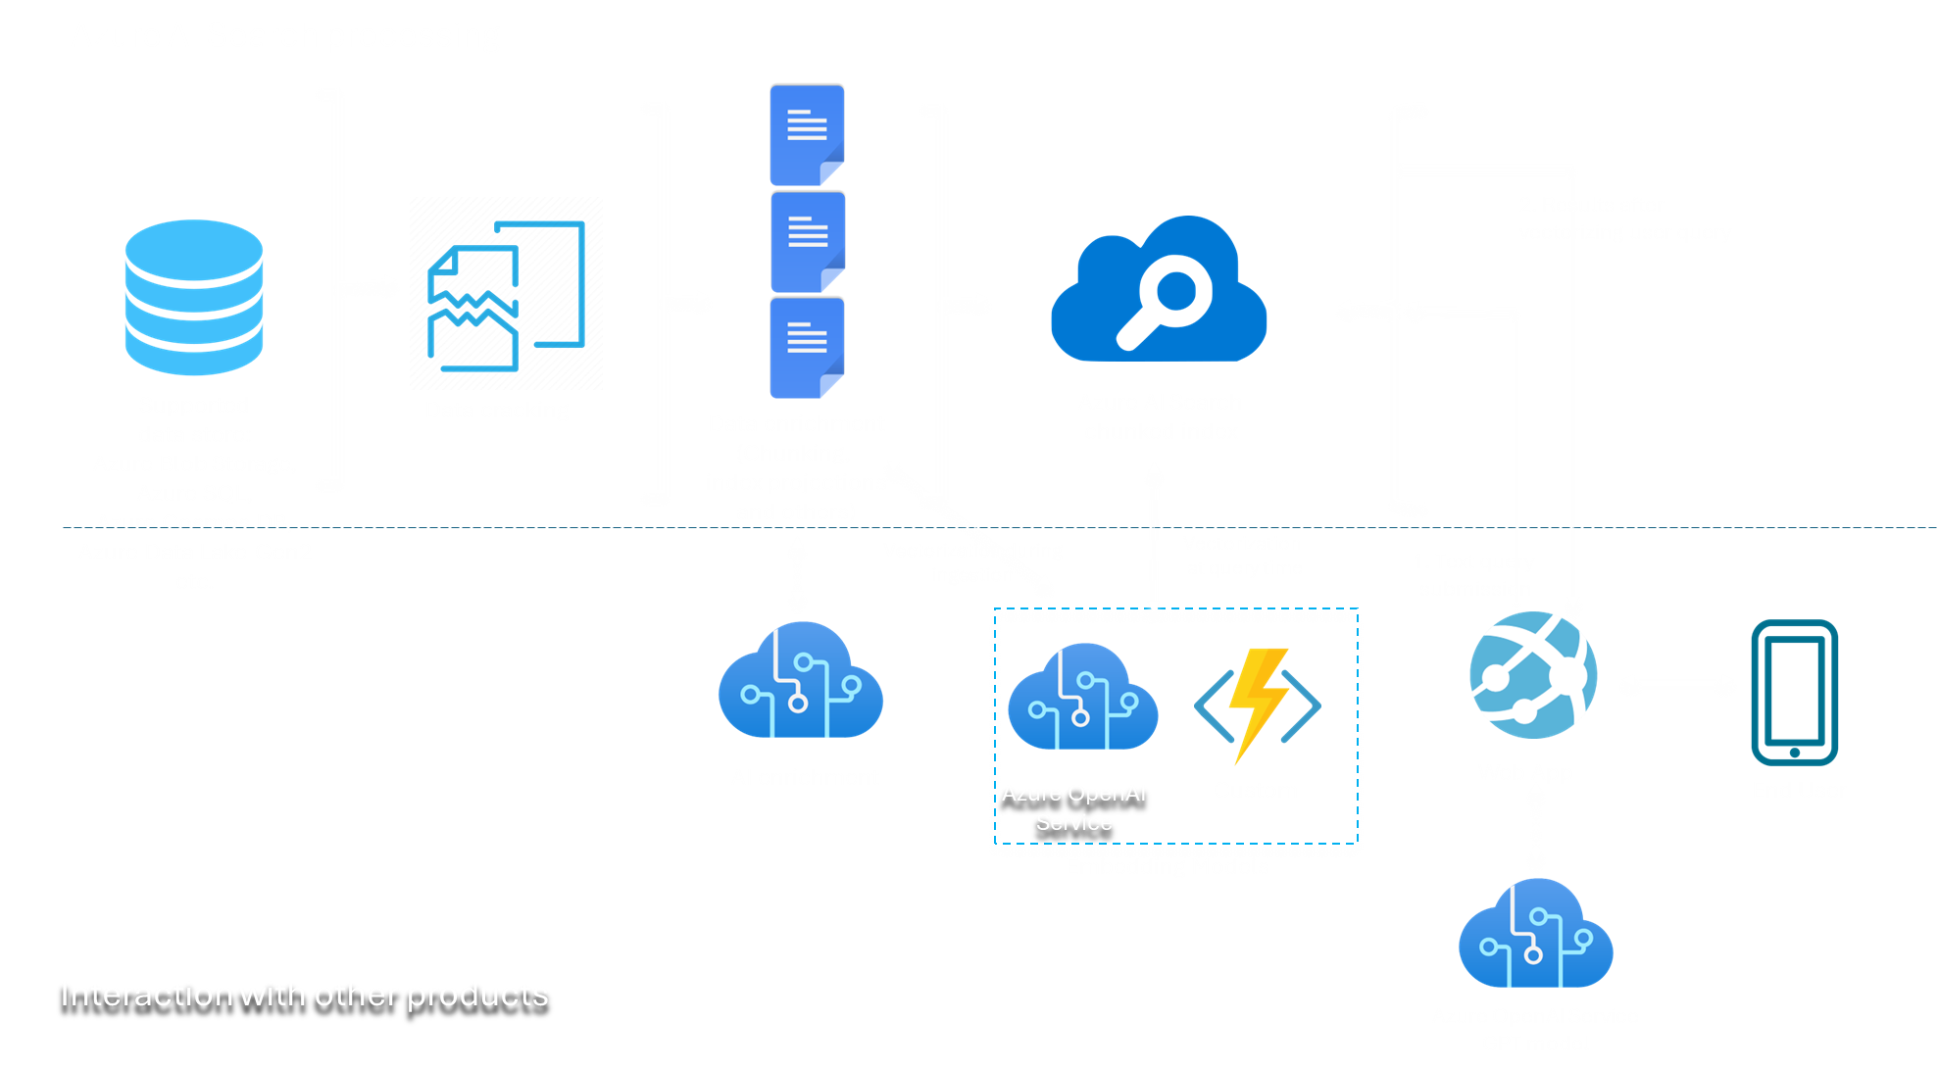
Introducing Integrated Vectorization Visualization End-to-end data ingestion, chunking, vectorization, and advanced retrieval

Slide 86
Chunking Skill
City eq 'New York
{
"@odata.type": "#Microsoft.Skills.Text.SplitSkill",
"description": "split documents into chunks",
"textSplitMode": "pages",
"maximumPageLength": 500,
"pageOverlapLength": 100,
"context": "/document",
"inputs": [
{
"name": "text",
"source": "/document/mergedText"
}
],
"outputs": [
{
"name": "textItems",
"targetName": "pages"
}
]
},
I want to chunk my documents via the Indexer orchestration pipeline with a built-in skill
This will be achieved by adding new functionality to existing Text split cognitive skill - Azure Cognitive Search | Microsoft Learn

Slide 87
Azure OpenAI service Embedding Skill
City eq 'New York
{
"@odata.type": "#Microsoft.Skills.Text.AzureOpenAIEmbeddingSkill",
"description": "Azure OpenAI Embedding Skill",
"context": "/document/pages/*",
"resourceUri": "https://my-openai-service.openai.azure.com",
"apiKey": “xxx",
"deploymentId": "text-embedding-ada-002",
"inputs": [
{
"name": "text",
"source": "/document/pages/*"
}
],
"outputs": [
{
"name": "embedding",
"targetName": "vector"
}
]
}
I want to generate embeddings via my Azure OpenAI endpoint

Slide 88
Custom Web API Skill
City eq 'New York
{
"@odata.type": "#Microsoft.Skills.Custom.WebApiSkill",
"description": "Custom API Embedding Skill",
"context": "/document",
"uri": "https://byoe.azurewebsites.net/api/embedding?code=YOUR-FUNCTION-KEY-HERE
"inputs": [
{
"name": "text",
"source": "/document/text"
}
],
"outputs": [
{
"name": "vector",
"targetName": "vector"
}
]
}
Use this if you prefer to build a custom Web API for your data processing and vectorization.

Slide 89
Search filter and RBAC
Approach | Description
Security trimming based on identity filters | Documents the basic workflow for implementing user identity access control. It covers adding security identifiers to an index, and then explains filtering against that field to trim results of prohibited content.
Security trimming based on Azure Active Directory identities | This article expands on the previous article, providing steps for retrieving identities from Azure Active Directory (Azure AD), one of the free services in the Azure cloud platform.
This workaround adds a string field in the data source that represents a group or user identity, which you can make filterable in your index.
The table describes two approaches for trimming search results of unauthorized content.
More details here

Slide 90
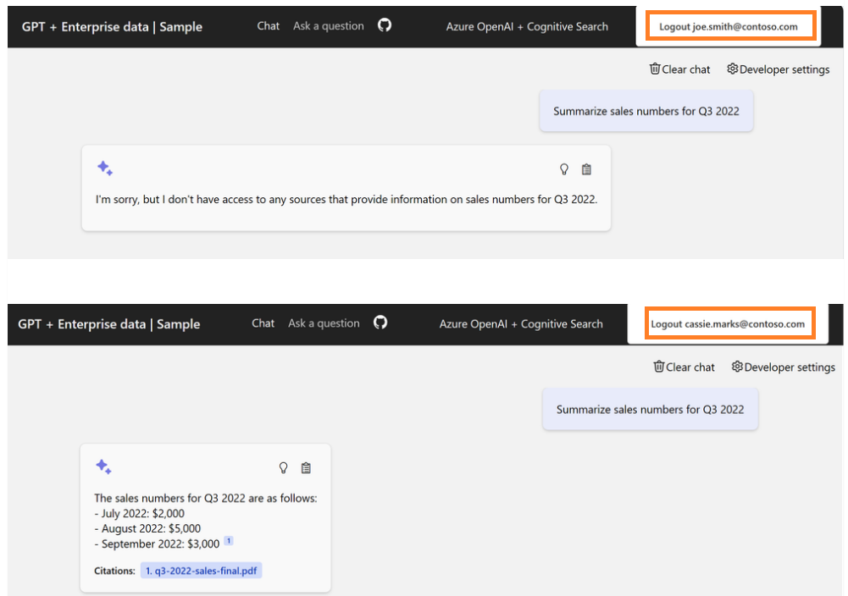
What does it mean to end users?
Answer is governed by access control

Slide 91
Security Feature
Secure and reliable
Built for the scale and performance needs of enterprises, with advanced security and privacy features
Scalability (partitioning, replication)
Encryption with customer managed keys (CMK)
Network Isolation and managed identify
Support for Azure Active Directory role-based access (RBAC) control
SLA of 99.9% availability with industry leading privacy and security
FedRamp
ISO 27001:2013
SOC 2Type 2
GxP (21 CFR Part 11)
HIPPAA and the HITECH act
(And more)

Slide 92
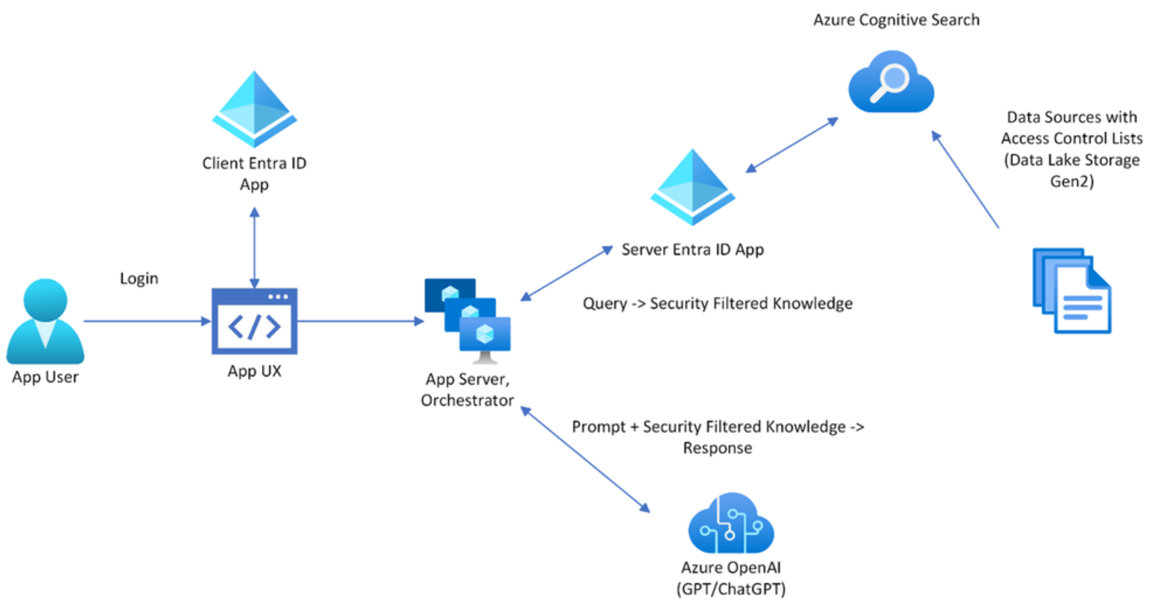
Integrated with Entra ID (AAD)
Access Control in Generative AI applications with Azure Cognitive Search - Microsoft Community HubAccess Control in Generative AI applications with Azure Cognitive Search - Microsoft Community Hub

Slide 93
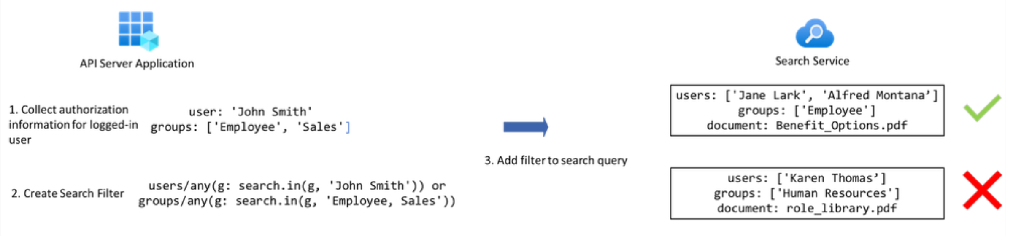
Sample Flow

Slide 94
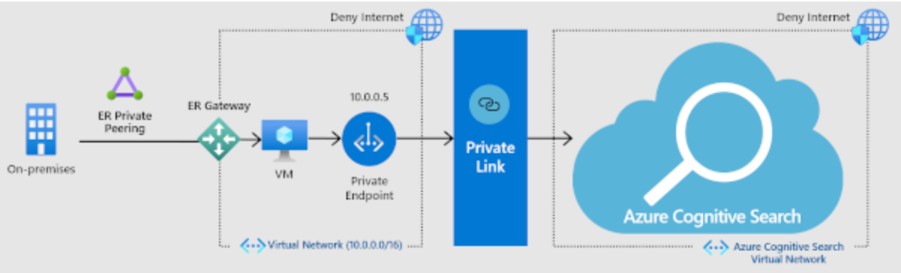
Private Endpoint
allows a client on a virtual network to privately and securely access data in a search index over a Private Link
The private endpoint uses an IP address from the virtual network address space for connections to your search service.
Network traffic between the client and the search service traverses over the virtual network and a private link on the Microsoft backbone network, eliminating exposure from the public internet.
A VNET allows for secure communication among resources, with your on-premises network as well as the Internet.

Slide 95
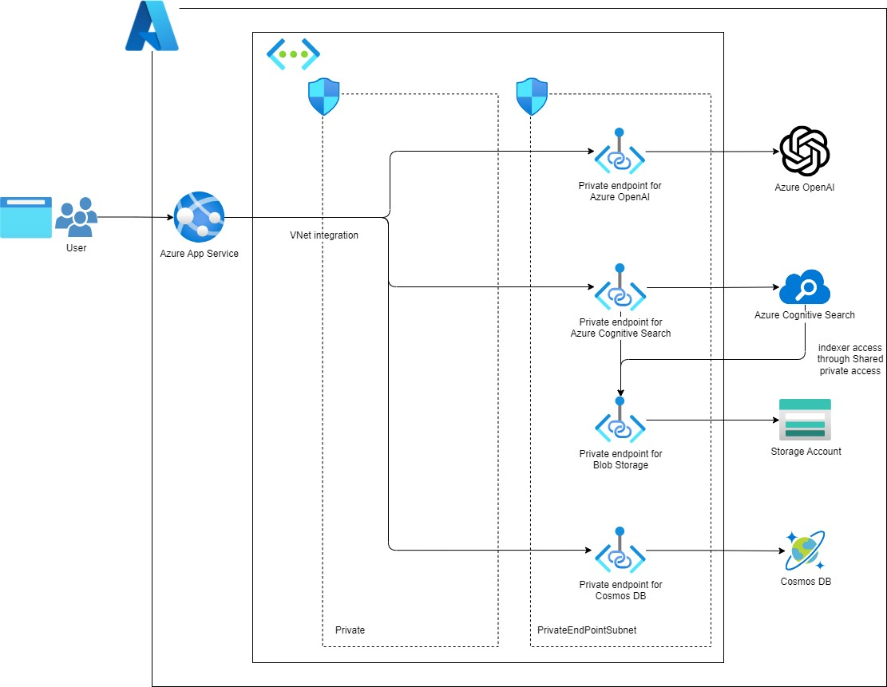
Sample Architecture with private access
Inbound access with private endpoint
Outbound access from Indexer to data source with Shared private access

Slide 96
Data residency
When you set up a search service, you choose a location or region that determines where customer data is stored and processed.
Azure AI Search won't store customer data outside of your specified region
Security overview - Azure AI Search | Microsoft Learn

Slide 97
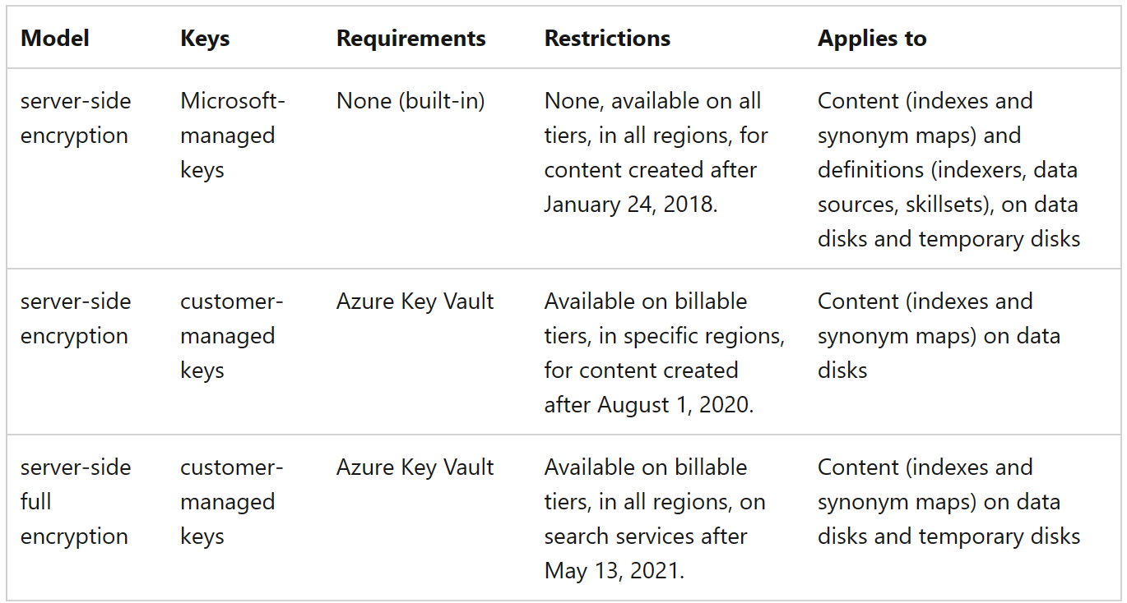
Data Protection
Data in transit:
encryption starts with connections and transmissions
All client-to-service connections use TLS 1.2 encryption
Data at rest:
Optionally, you can add customer-managed keys (CMK) for supplemental encryption of indexed content for double encryption of data at rest.

Slide 98

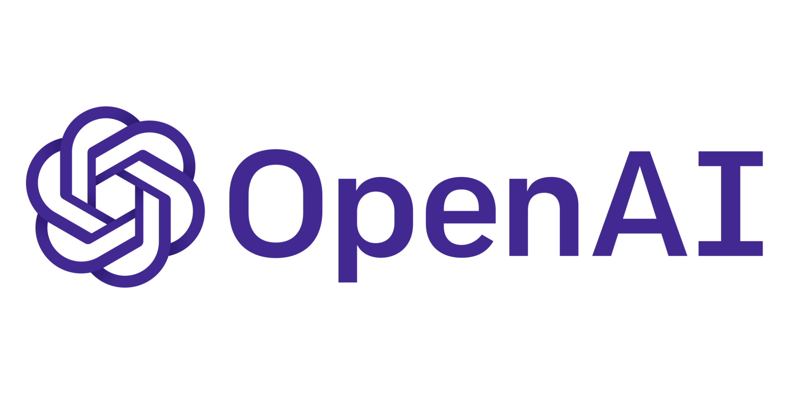





Catalogue search/ Product Discovery Search
Surface relevant product details for your customers
Azure AI Search
If data is structured, customer may not require enrichment and can head straight to indexing
Search index in AI Search
Query/Search Retrieval
Azure Storage
If data is unstructured, data requires enrichment via built in or custom skills enrichment
Built-in skills
(Azure AI Text Analytics, Azure AI Vision)
Ingest
Azure Web App
If data is too large for AI prompts or vectors requires data chunking
Azure AI Text Analytics
Products, pricing catalogue, orders
Enriched document in knowledge store
Exploration/ Ongoing Analytics
Vector Embeddings
Invoicing sales
Custom Skills/ OpenAI LLM, other Azure AI services/ Machine Learning model
Knowledge Store
(Azure Table or Blob)
Integrations/Features:
Azure storage for loading documents (see data source gallery)
Enrichment with OpenAI LLM/Azure AI services/ML if custom skills needed
Custom skill for vector embedding creation. Power Skill for chunking + vector embedding generation
Frontend/Backend integrations to web apps/LOB app
Azure Architecture Center:
Knowledge mining for content research - Azure Solution Ideas | Microsoft Docs
Knowledge mining in digital asset management - Azure Solution Ideas | Microsoft Docs

Slide 99
Demo

Slide 100
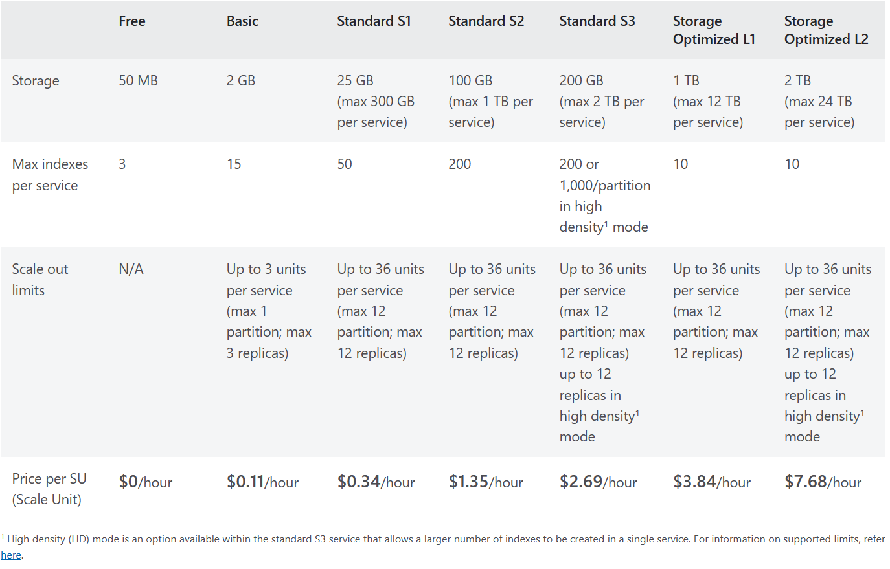
Pricing
Estimate capacity for query and index workloads - Azure AI Search | Microsoft Learn
Elastic scale
You get to pick your tier of service depending on your needed capacity
Each tier is then scalable in two dimensions on storage and partitions
Capacity can be changed dynamically
Replicas ~ more QPS, HA
Partitions ~ more documents, write throughput

Slide 101
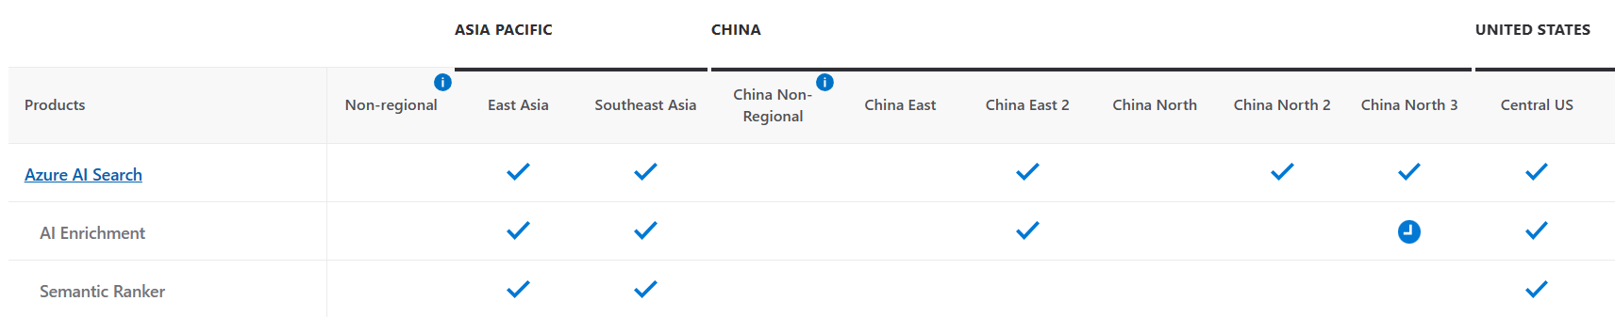
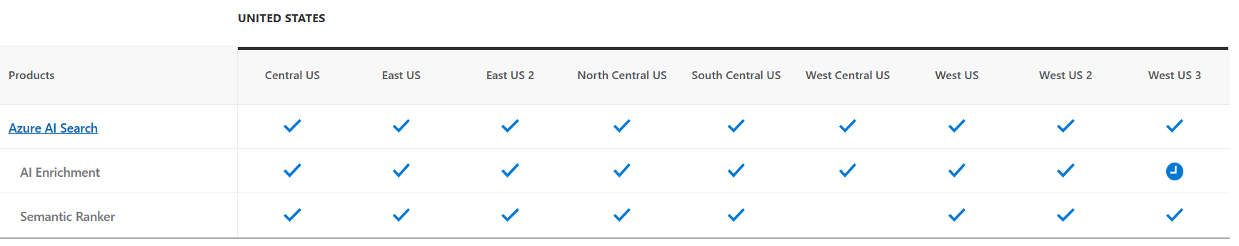
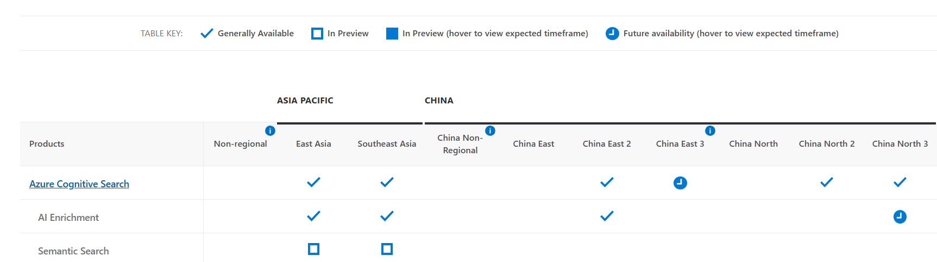
Supported Region
Azure Products by Region | Microsoft Azure

Slide 102
Availability zone
In AI Search, individual replicas are the units for zone assignment. A search service runs within one region; its replicas run in different physical data centers (or zones) within that region.
Prerequisites
Service tier must be Standard or higher.
Service region must be in a region that has available zones
Configuration must include multiple replicas: two for read-only query workloads, three for read-write workloads that include indexing.
The replicas are distributed across zones as evenly as possible as long as the prerequisites are met
Reliability in Azure AI Search - Azure AI Search | Microsoft Learn

Slide 103
Additional Resources
Repos
Docs
Azure Cognitive Search as a vector database for OpenAI embeddings | OpenAI Cookbook
Azure Cognitive Search — 🦜🔗 LangChain 0.0.198
Azure Cognitive Search - LlamaIndex 🦙 0.8.46 (gpt-index.readthedocs.io)
Azure-Samples/azure-search-openai-demo (github.com)
Azure-Samples/chat-with-your-data-solution-accelerator: A Solution Accelerator for the RAG pattern running in Azure, using Azure Cognitive Search for retrieval and Azure OpenAI large language models to power ChatGPT-style and Q&A experiences. This includes most common requirements and best practices. (github.com)
Azure-Samples/azure-searc-comparison-tool: A demo app showcasing Vector Search using Azure Cognitive Search, Azure OpenAI for text embeddings, and Azure AI Vision for image embeddings. (github.com)
Vector search - Azure Cognitive Search | Microsoft Learn
Azure/cognitive-search-vector-pr: Private repository for the Vector search feature in Azure Cognitive Search. (github.com)
Azure OpenAI Service - Documentation, quickstarts, API reference - Azure Cognitive Services | Microsoft Learn
Image Retrieval concepts - Image Analysis 4.0 - Azure Cognitive Services | Microsoft Learn
Azure Cognitive Search: Outperforming vector search with hybrid retrieval and ranking capabilities - Microsoft Community Hub

Slide 104

Upcoming Partner Enablement Sessions
Microsoft Azure Infrastructure updates (Nov 2023)
Thursday, Nov 29, 2023
2:30 PM– 3:30 PM Hong Kong Time
Click to register
Azure OpenAI update & workshop Train-the-trainer
Thursday, Dec 7, 2023
10:00 AM– 12:00 NN Hong Kong Time
To get latest formation: Training and Events (microsoft.com)

Slide 105
Thank you.

